Slide 1
HIV infection in Africa: "Therapeutic Challenges and Emerging Resistances”
Defeating HIV in Africa: an Achievable Goal
Prof. Carlo Federico Perno
Bambino Gesù Children's Hospital, IRCCS

Slide 2
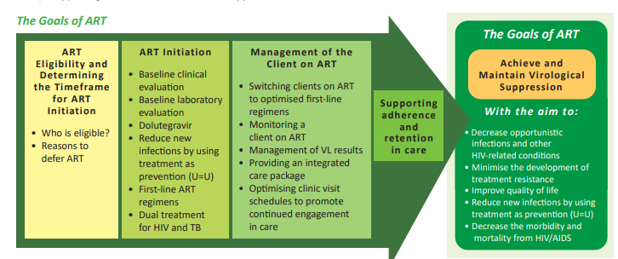
Goals of HIV Therapy
… Durable viral suppression is the most important goal of ARV treatment^{1,2,3}
Indefinitely maintain suppression of plasma HIV RNA levels below the level of detection of sensitive of HIV RNA assays
Maximal and durable suppression of plasma viremia to delay or prevent the selection of drug-resistance mutations, preserve or improve CD4 count, and confer substantial clinical benefits
A new keyword to be implemented in our fight against HIV infection:
"MAINTAIN", not "OBTAIN».
Maintain virus under FULL control (UNDETECTABLE) for decades IS AN
Essential ACHIEVEMENT to offer a RELIABLE chance of normal life to our patients
Achieving suppressed viral load is just the beginning of the job……
PLWH on ART who do not achieve durable viral suppression can develop resistance mutations to one or more components of their regimen
FDA. Human Immunodeficiency Virus-1 Infection: Developing Antiretroviral Drugs for Treatment Guidance for Industry. November 2015.
DHHS. Guidelines for the Use of Antiretroviral Agents in Adults and Adolescents Living with HIV, Sep 2024. Available at: http://aidsinfo.nih.gov/guidelines
ART Clinical Guidelines for the Management of HIV in Adults, Pregnancy and Breastfeeding, Adolescents, Children, Infants and Neonates. Republic of South Africa National Department of Health, April 2023

Slide 3
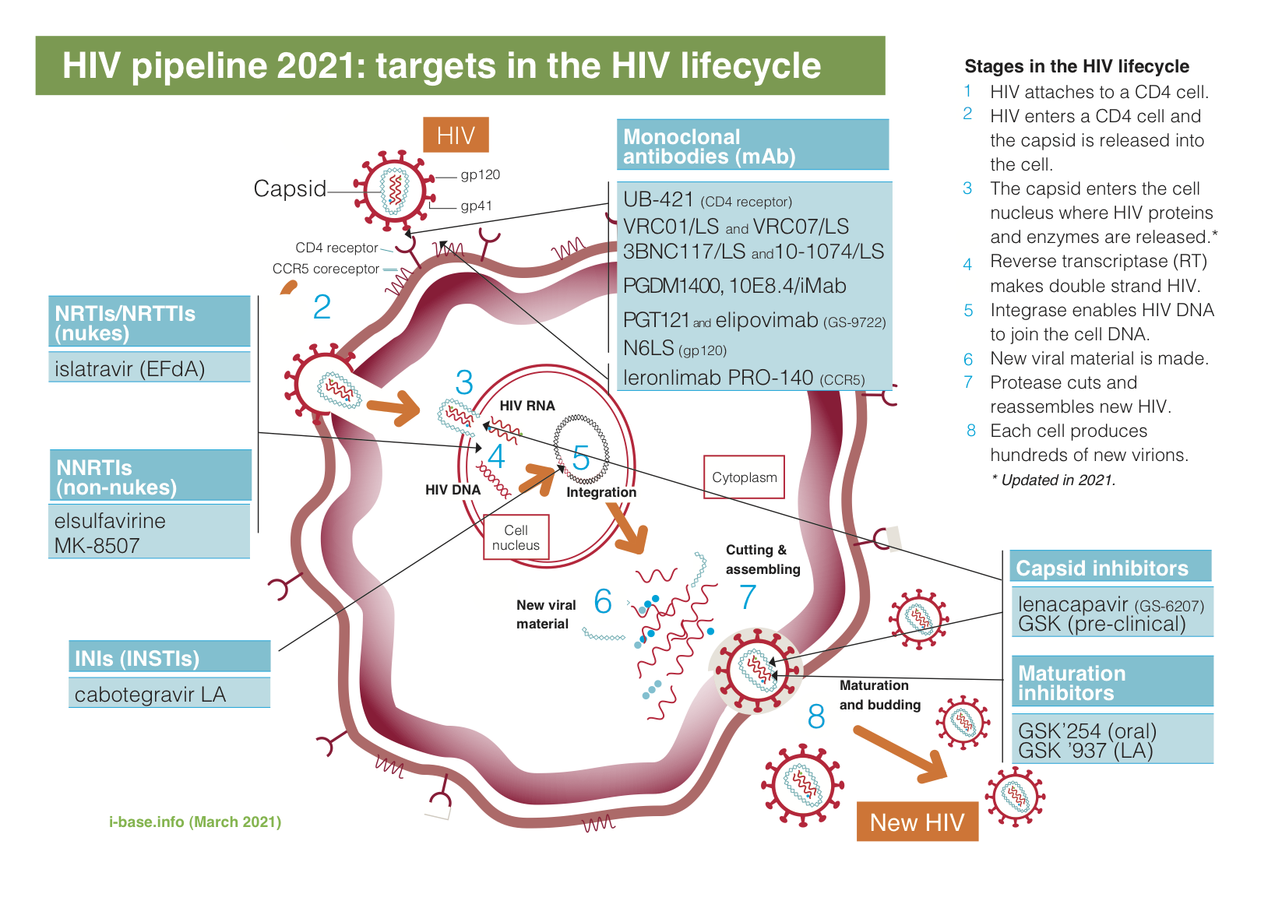
Limited options are on the horizon for limited resource countries in case of failure of TLD
We need to use at best the antiviral regimens we have, and preserve their efficacy in order to mantain lifetime the control of virus replication

Slide 4
WE NEED NOW A NEW WAY OF THINKING AND OF ACTING, IN LINE WITH THE EXTRAORDINARY CHANGE THAT WAS IMPLEMENTED IN 2001-2002 ABOUT THE THERAPY OF HIV INFECTION IN RESOURCE LIMITED SETTINGS
IT IS TIME TO DO SO, AND WE HAVE THE TECHNICAL RESOURCES TO DO SO
Notes:
Ships do not sail the seas to sail the seas, but to discover new worlds

Slide 5
FROM THE MINIMUM TO EVERYONE, TO THE BEST POSSIBLE TO EACH PERSON
HOW TO DO THIS?
1. TAILORED THERAPY
2. USE OF DIAGNOSTIC TOOLS

Slide 6
FROM THE MINIMUM TO EVERYONE, TO THE BEST POSSIBLE TO EACH PERSON
HOW TO DO THIS?
1. TAILORED THERAPY
2. USE OF DIAGNOSTIC TOOLS

Slide 7
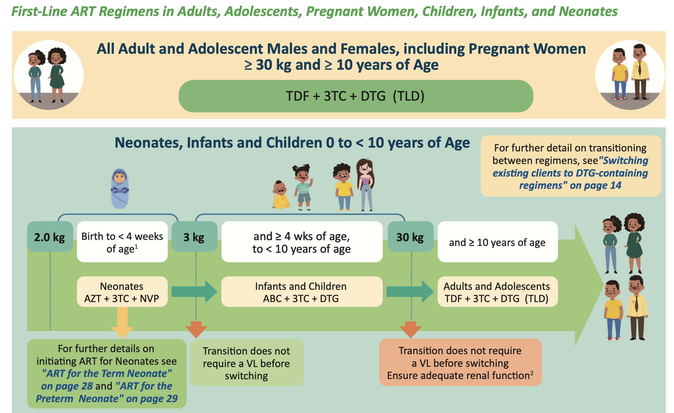
HIV Treatment in Africa: Use of DTG-based Regimens
DTG-based therapies in Africa have been adopted in most countries as preferred first-line regimen and in case of multi-drug resistance. Over 25 million PLHIV are under dolutegravir (DTG)-based ART
• With DTG being the cornerstone of the current HIV treatment strategies, monitoring of its efficacy to ensure long-term and sustained treatment outcomes is paramount

Slide 8
HIV Treatment in Africa: Use of DTG-based Regimens
Efficacy of DTG-based therapies
DTG-based ART has increased the number of people living with HIV who achieve viral suppression. In effect, DTG is associated with a higher proportion of patients achieving viral suppression at 96 weeks compared with other ART regimens.
DTG-based ART has improved clinical outcomes, including viral suppression.
In Uganda: DTG-based ART has been well-accepted in Uganda, with a high viral suppression rate of 94% at 6 months.
In Cameroon: The NAMSAL trial in Cameroon helped solidify DTG as the first-line treatment in resource-limited settings.

Slide 9
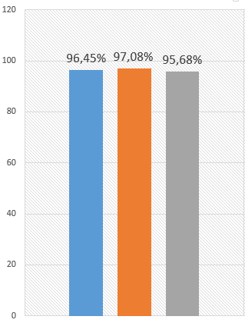
HIV treatment in Africa: use of DTG-based regimens
Efficacy of DTG-based: Data from Cameroon
Virological success after DTG-containing 3L
Virological response in the study population
>89% of Viral suppression rates in 3L after multiple ART-failure
>95% of Viral suppression rates in 1L
Semengue et al. 2022 Mbouyap et al. 2023

Slide 10
- TLD is an extraordinary therapeutic resource for HIV infection, similar, or in many cases, even better than what is available in rich countries
- It is a game changer…….. But it is not invulnerable
- In some patients, particularly with previous resistance to antivirals, it may not work
- If it fails, it generates resistance to the whole regimen, including dolutegravir
After failure of TLD with resistance, not so much remains - Limited chances of maintaining the virus under control for years.
Without interventions, the number of TLD-failing patients will increase

Slide 11
FROM THE MINIMUM TO EVERYONE, TO THE BEST POSSIBLE TO EACH PERSON
HOW TO DO THIS?
1. TAILORED THERAPY
2. USE OF DIAGNOSTIC TOOLS

Slide 12
Since almost forty years, CD4 count is known to be:
the most important laboratory indicator of immune function in patients with HIV
the strongest predictor of disease progression and survival

Slide 13
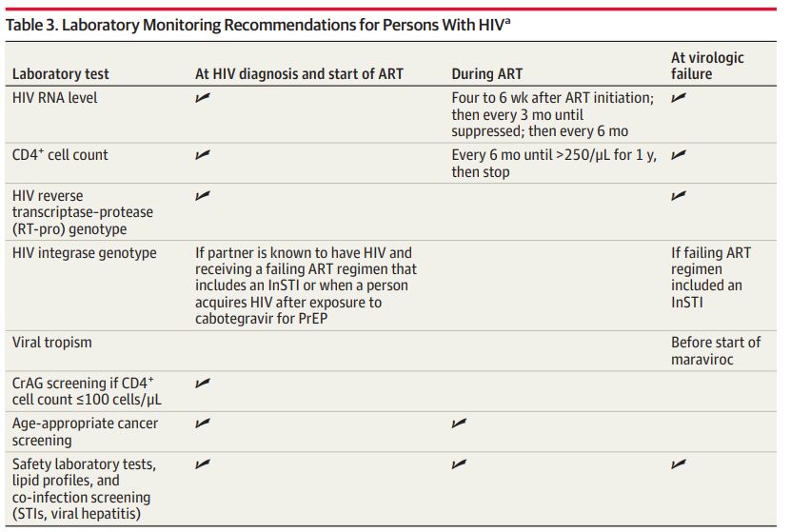
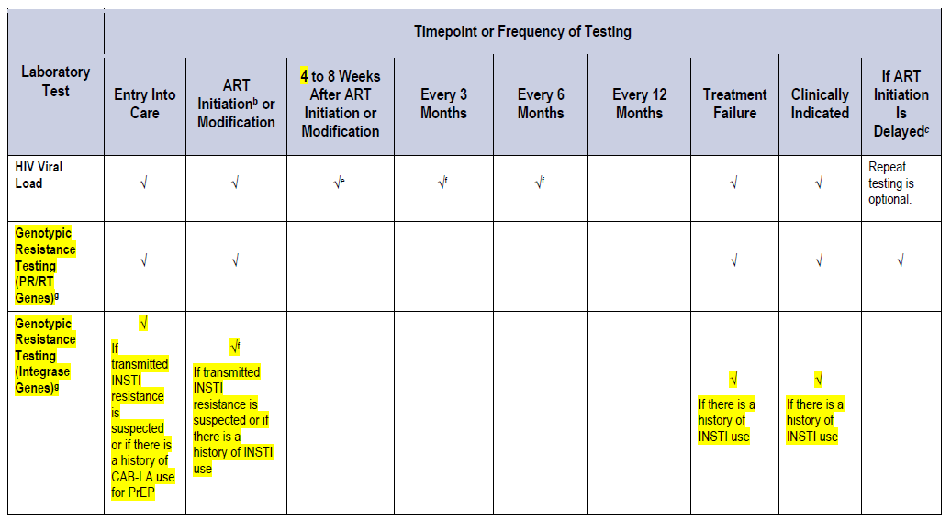
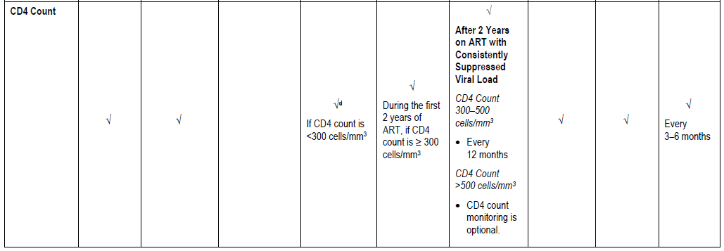
CD4⁺ cell counts and HIV-RNA level should be measured in all patients:
At HIV-1 diagnosis
At start of therapy
During follow-up to monitor therapeutic response
At virologic failure
Antiretroviral Drugs for Treatment and Prevention of HIV in Adults:
2024 Recommendations of the International Antiviral Society-USA Panel. JAMA.
Guidelines for the Use of Antiretroviral Agents in Adults and Adolescents With HIV. DHHS guidelines, 2024.

Slide 14
HIV viral load and CD4 are key parameters to assess the evolution of the disease and the efficacy of antivirals.
Their use needs to be implemented in Africa to the european standards
Technically feasible, not particularly expensive, the logistics is already in place
A hub-and-spoke approach to diagnosis is the standard in many resource-rich and resource-limited countries, for HIV and not only
The great efficacy of TLD, together with the limited options beyond it, advocates for an adequate monitoring of treatment, ready to change therapy before the virus develops resistance

Slide 15
HIV-1: Drug resistance development
Drug-susceptible quasispecies
Drug-resistant quasispecies
The development of resistance against antiviral drugs is a natural phenomenon for HIV
It is the rule and not the exception in case of inadequate treatment
The earlier is the intervention, the lower is the chance of development of resistance, particularly in case of drug combinations with high genetic barrier
Treatment begins
Selection of resistant quasispecies (failure)
Incomplete suppression
Inadequate potency
Inadequate drug levels
Inadequate adherence
Preexisting resistance
Viral Load
Time (months)
Today it is possible to detect resistant quasispecies even before the treatment starting or soon at failure.

Slide 16
The development of resistance against antiviral drugs is a natural phenomenon for HIV
It is the rule and not the exception in case of inadequate treatment
The earlier is the intervention, the lower is the chance of development of resistance, particularly in case of drug combinations with high genetic barrier
This is particularly true in case of use of TLD after failure of previous regimens: Functional TLD monotherapy

Slide 17
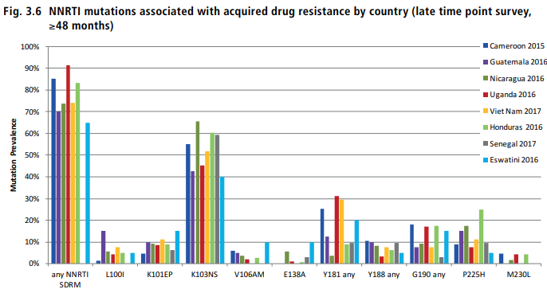
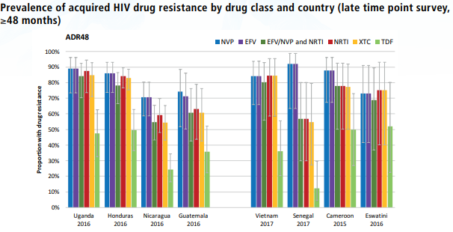
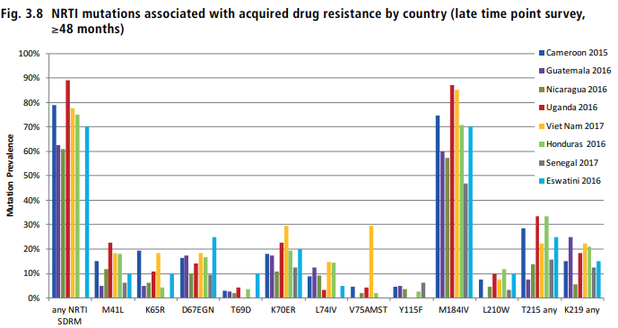
Prevalence of acquired HIV drug resistance by drug class and country
The large majority of patients failing previous non TLD-regimens carry resistance to antivirals.
This can hamper the efficacy of TLD used after failure of NRTI/NNRTI-based regimens
Mutations associated with acquired drug resistance​
HIV DRUG RESISTANCE REPORT 2021

Slide 18
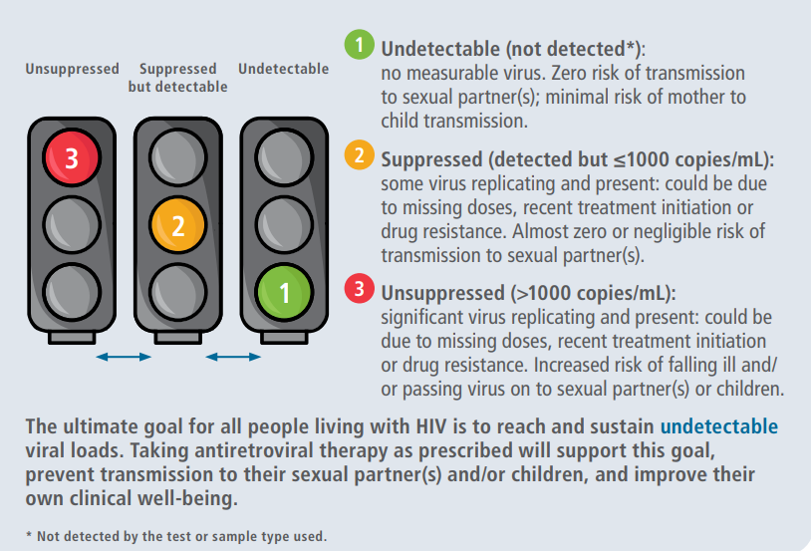
Three categories of Viral Load levels
Viral load testing uses PCR technology that is known to be inherently variable, even using the most sophisticated and accurate reference standards.
For example, a viral load of 1000 copies/mL (even if using a plasma specimen and a laboratory-based assay) has a known and accepted variability in the range of 500–2000 copies/mL, meaning that if you repeated the test the result would likely be anywhere within that range.
Lelie N, et al. J Med Virol. 2020
https://www.who.int/publications/i/item/9789240055179

Slide 19
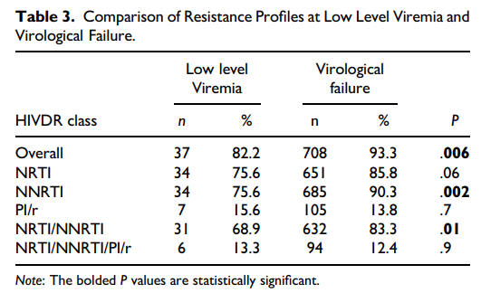
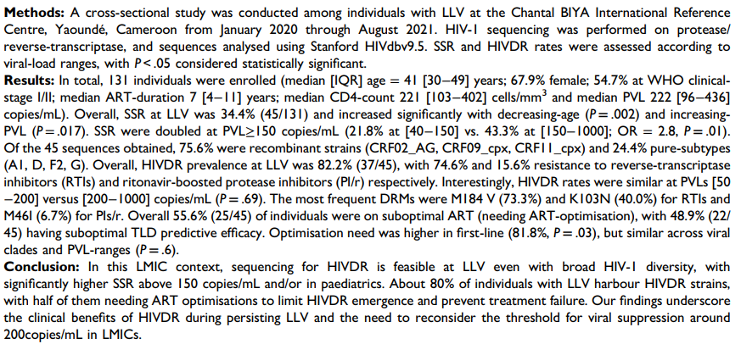
Comparing drug resistance levels in LLV individuals with virologically failing individuals (VL≥ 1000 copies/mL), those on virological failure had significantly higher rates of overall HIVDR (P = 0.006), of NNRTI resistance (P= .002) and of NRTI/NNRTI dual class resistance (P = .01). Rate of NRTI resistance was on the threshold of significance (P = .06), while PI/r and triple class resistance were similar (P= .7 and .9 respectively)
Chenwi et al., J Inte Association of Providers of AIDS Care 2024
We evaluated sequencing success rates (SSR) at LLV, described HIVDR profiles and adequacy with potential efficacy of tenofovir-lamivudine-dolutegravir (TLD).

Slide 20
Resistance profile among participants with VF depending on previous viremia exposure
Between 50 and 1,000 copies, virus often replicates, therefore is able to generate resistance mutations, that ultimately may cause failure of antiviral therapy
Its achievement is an excellent starting, not the final outcome
Undetectable virus should be the goal of our therapy to maintain success for decades
Among 1424 cases of VF, 338 (24%) had a recorded DRM result obtained within the first year after incident VF.
Among persons with VF who were classified as LLV, 42% had detectable DRMs; the corresponding proportions were 50% and 59% for viral suppression and blips, respectively.
Elvstam O, et al. Clin Infect Dis. 2023

Slide 21
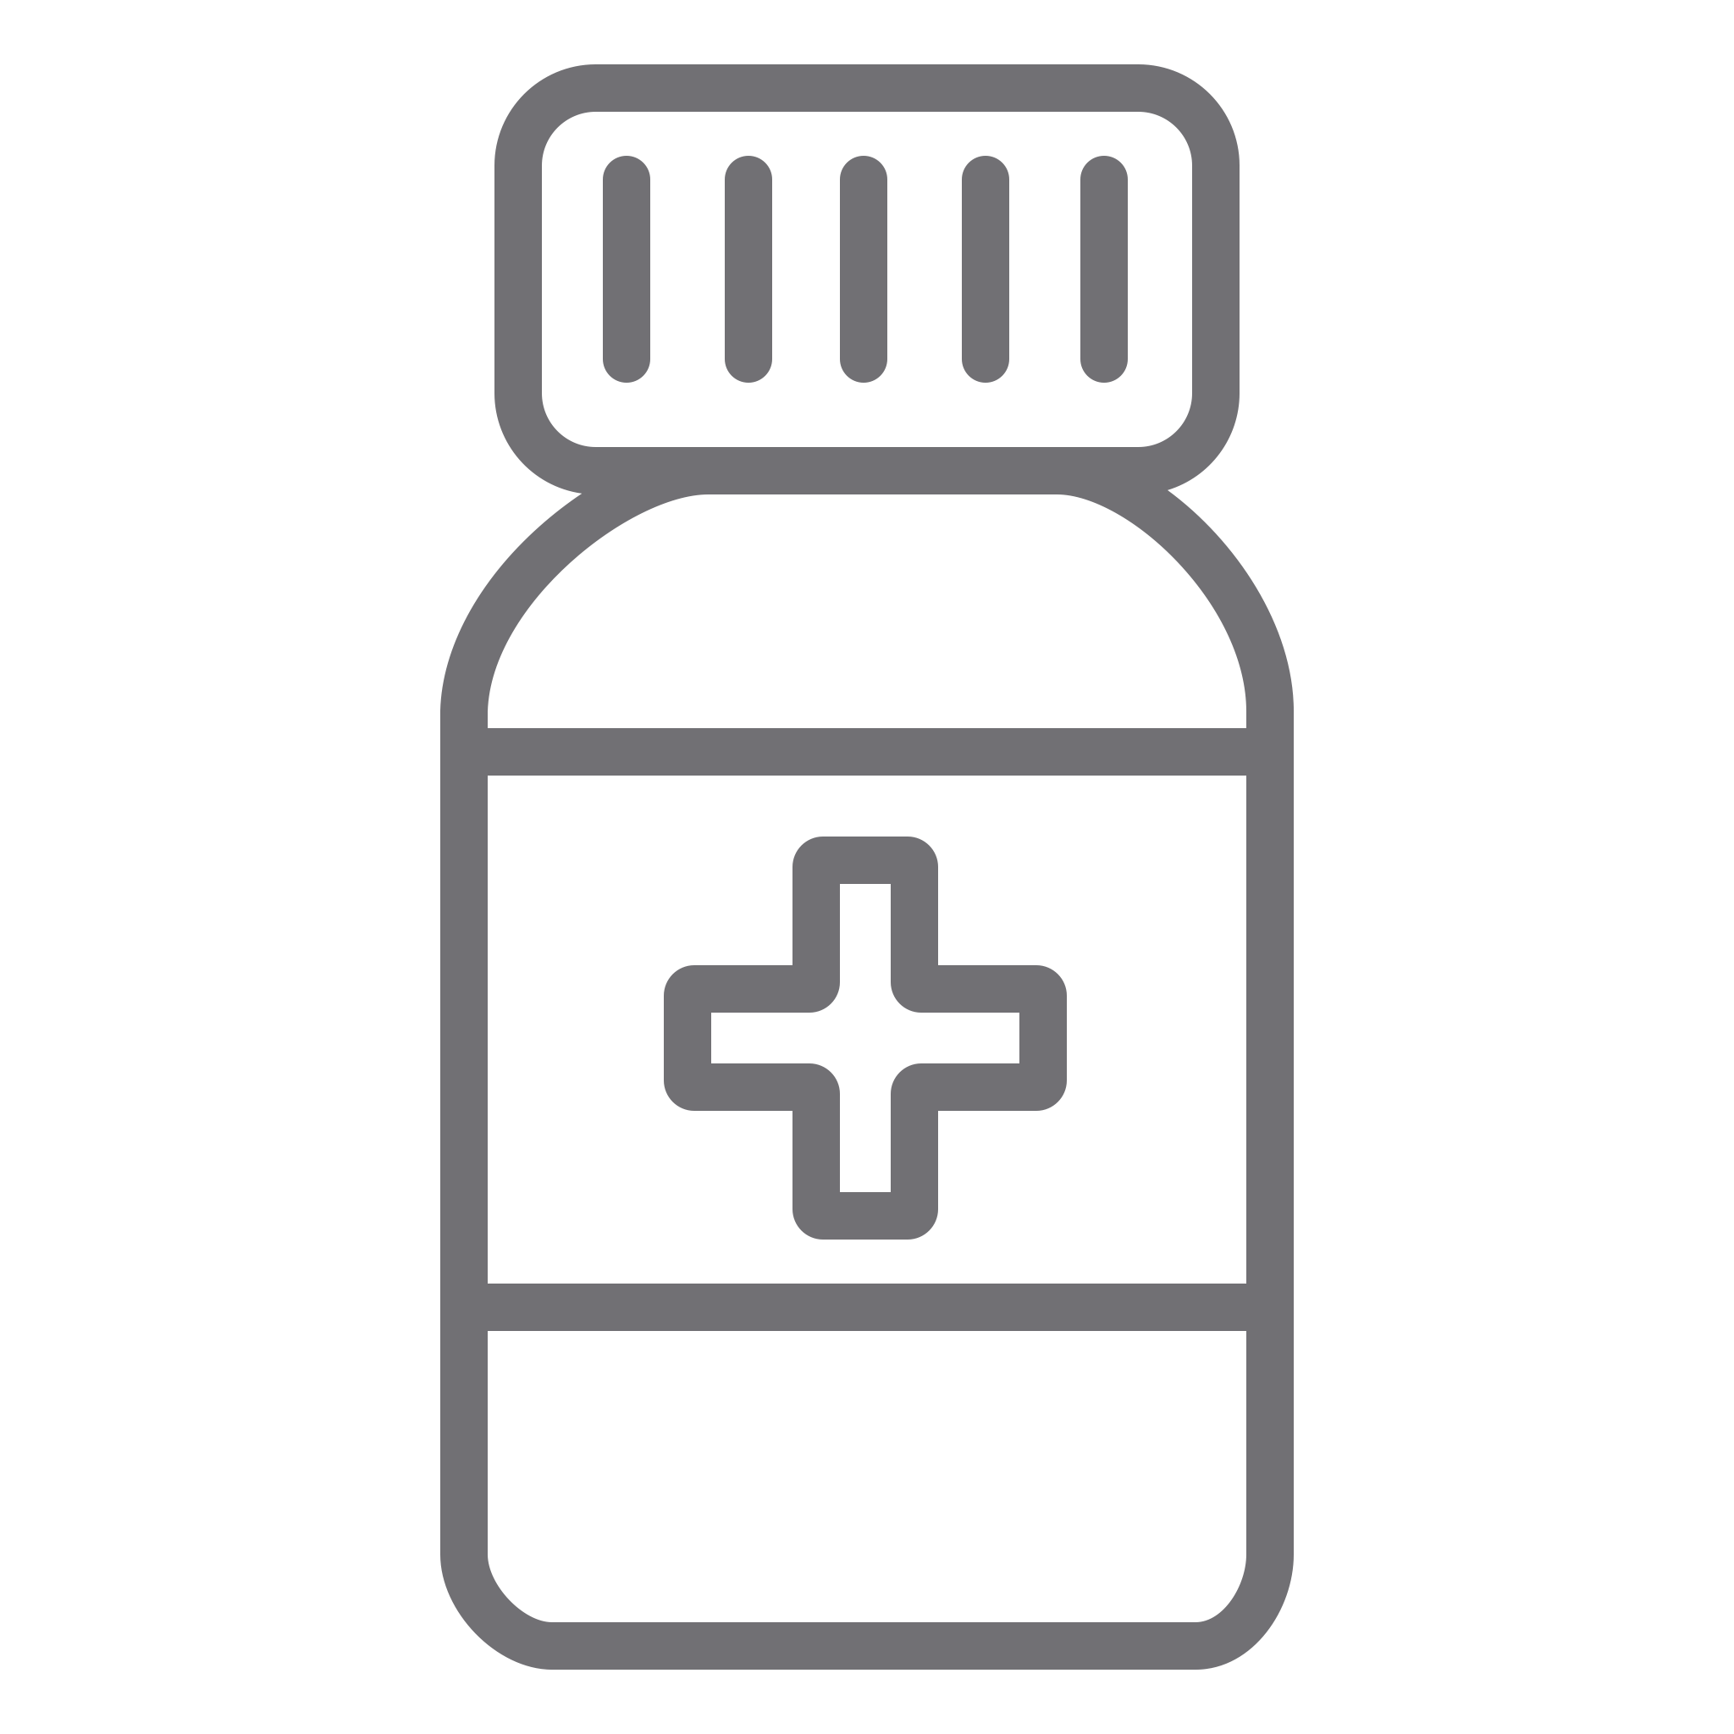
EACS Guidelines on HIV Resistance Testing
EACS treatment guidelines recommend HIV RNA genotypic resistance testing:
As soon as possible after diagnosis in all cases
Prior to initiation of ART
In pregnant women whose HIV RNA level is not undetectable at third trimester
In PLWH failing treatment
Usually routinely available for HIV RNA levels
> 200–500 c/mL and in specialised laboratories for lower levels of viremia
EACS Guidelines, version 12.0, Oct. 2023.

Slide 22
DHHS Recommendations Drug-Resistance Assays
Clinical Setting | Recommendation
Acute HIV, Chronic HIV | RNA Genotypic
Treatment-naive, Entry to Care | RNA Genotypic
Virologic Failure HIV RNA >1000 copies/mL HIV RNA 500-1000 copies/mL On INSTI-based regimen With known/suspected complex resistance patterns | RNA Genotypic RNA Genotypic RNA Genotypic with INSTI resistance RNA Genotypic + Phenotypic
Pregnancy (prior to treatment initiation or with detectable viral load) | RNA Genotypic
Undetectable Viral Load or Low-level Viremia | Proviral DNA Genotypic (RNA genotypic assay is unlikely to be successful)
Timing of HIV-Drug Resistance Testing
For ART-Naïve PLWH: HIV drug-resistance testing is recommended at entry into care. ART initiation should not be delayed while awaiting resistance testing results; regimen can be modified once results are reported
For ART-Experienced PLWH (in the setting of VF or incomplete suppression): While the person is taking prescribed ARV drugs or, within 4 weeks after discontinuing therapy. After 4 weeks of ARV discontinuation, resistance testing may still provide useful information; however, previously selected resistance mutations can be missed due to lack of drug-selective pressure
RNA Genotypic assay is generally the preferred resistance testing to guide therapy decisions
All prior and current drug-resistance test results should be considered when constructing a new regimen
VF, Viral failure
DHHS. Guidelines for the Use of Antiretroviral Agents in Adults and Adolescents Living with HIV, 2023. Available at: http://aidsinfo.nih.gov/guidelines

Slide 23
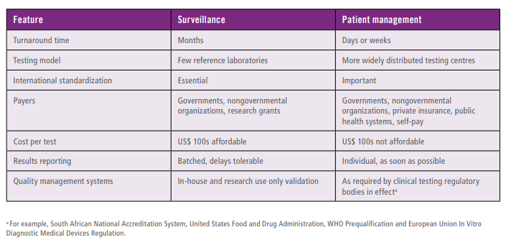
There are several important differences between implementing drug resistance testing for patient management and for surveillance purposes.
Contrast between implementing drug resistance testing for surveillance and for patient management in low- and middle-income countries
Turning resistance test just from surveillance (indirect clinical relevance) to patient management (clinically relevant) is important from the clinical standpoint, and feasible
Target product profile for HIV drug resistance tests in low- and middle-income countries: Africa

Slide 24
HIV Drug resistance testing in Central Africa: Experience of Cameroon
Courtesy of Dr Joseph Fokam

Slide 25
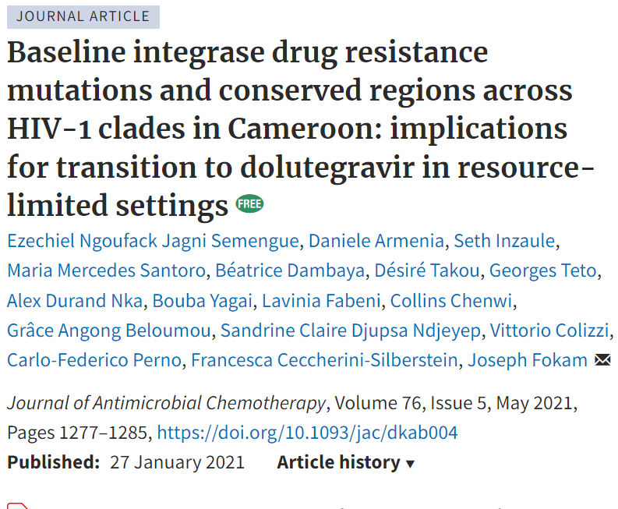
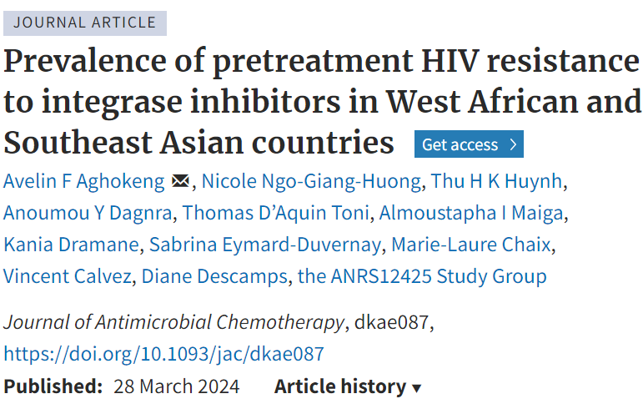
Pretreatment Drug resistance to DTG is low (<1% in Cameroon), supporting transition to DTG based regimens)

Slide 26
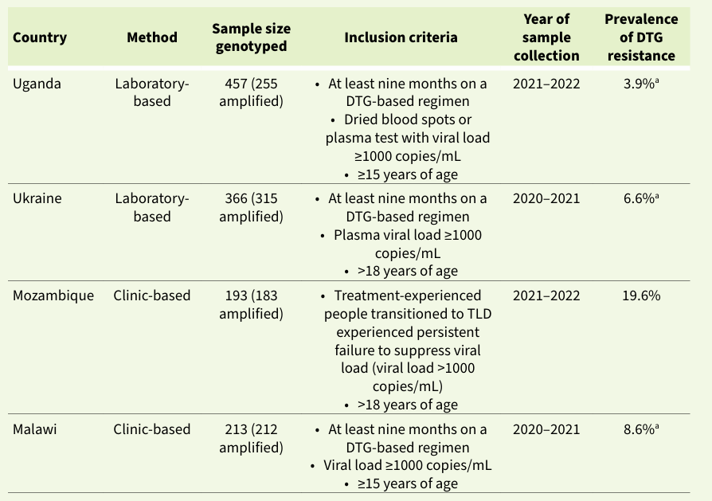
HIV drug resistance to DTG among adults receiving DTG-based ART in PEPFAR-supported surveys, 2020–2022
WHO, February 2024
“Standardised surveillance of HIVDR to follow the prevalence and patterns of resistance among people not achieving suppressed viral load is crucial”
WHO HIVDR report, 2024

Slide 27
Objectives
Evaluate levels of HIV drug resistance (HIVDR) to integrase strand transfer inhibitors (INSTI), in patients exposed to DTG in Cameroon.

Slide 28
Study workflow
Number assessed
N= 1420
Non DTG based regimens
n = 1168
Excluded
On DTG based regimens
n = 252
Excluded
VL ≥ 1000 copies/ml
n = 185
VL < 1000 copies/ml
n = 68
Excluded
Successful partial pol sequencing
n = 144
Sequencing unsuccesful
n = 41
RT-PR-INT sequenced
n =36
Only RT-PR
sequenced
n =108

Slide 29
Study population characteristics
 | Overall (n=144) | RT-PR-INT (n=36) | RT-PR (n=108)
Median age [IQR], years | 24 [15-44] | 29 [17-48] | 22 [15-44]
Sex, n (%)
- Females | 75 (52.1) | 19 (52.8) | 56 (51.9)
- Males, | 69 (47.9) | 17 (47.2) | 52 (48.2)
Median CD4 [IQR], cells/mm3 | 321 [170-576] | 319 [200-388] | 365 [122-590]
Median viral load [IQR], copies/ml | 53 313 [8 162-168 223] | 45 146 [12 600-130 668] | 55 326 [6 612-168 991]
Median duration on ART [IQR], years | 8 [5-14] | 10 [4-16] | 8 [5-12]
Duration of DTG exposure [IQR], months | 14 [8-25] | 19 [9-35] | 12 [7-24]
Line of treatment, n (%)
- First-line | 53 (36.8) | 11 (30.6) | 42 (38.9)
- Second-line | 41 (28.5) | 8 (22.2) | 33 (30.6)
- Third-line | 50 (34.7) | 17 (47.2) | 33 (30.6)
Subtype distribution, n(%)
- CRF02_AG | 91 (63.2) | 20 (55.7) | 71 (63.9)
- G | 10 (7.0) | 2 (5.6) | 8 (7.4)
- A1 | 8 (6.3) | 2 (5.6) | 6 (5.6)
- CRF18_cpx | 6 (4.2) | 1 (2.8) | 5 (4.6)
- F2 | 5 (3.5)) | 1 (2.8) | 4 (3.7)
- D | 4 (2.8%) | 1 (2.8) | 3 (2.8)
- Others* | 19 (13.3) | 8 (22.2) | 11 (10.2)
*Other viral clades: 01_AE, 11_cpx, 13_cpx, 09_cpx, 37_cpx_26_AU, 37_cpx, F1, F1/G, 02_AG/G

Slide 30
High rates of INSTI resistance (14/36, 38.9%) in population failing TLD with available RT-PR-INSTI sequences

Slide 31
Scenario 1: Transition from NNRTI-based first-line to TLD (DTG functional monotherapy!)
ID | Age, sex | CD4 count Cell/mm3 | Viral load copies/ml | Subtype | INSTI Mutations | RT mutations | PI mutations | Risk factors
61462 | 33, M | 12 | / | A1 | R263RK | K65R, K101E, Y181C, M184V, G190S | None | Poor adherence, viral non-suppression; Inappropriate transition from TLE to TLD
91350 | 35, M | / | 1 695 | CRF13_cpx | R263RK | A62V, K65R, A98G, K103N, V108I, M184V, K219E | None | Poor adherence, viral non-suppression; transition from TLE to TLD
85347 | 52, M | / | 2 750 | CRF02_AG | T97A, E138K, S147G, N155H. | M41L, K103S, M184V, G190A L210W, T215F | None | Transition from AZT+3TC+NVP to TLD With viral non-suppression;
ADOLA FCB 088 | 17, M | 388 | 18 717 | G | L74M, G118R, E138K | M41L, Δ67, K70R, L74V, K101E, V108I, Y181C, M184V, G190A, T215F, K219E | None | Transition from AZT+3TC+NVP to ABC-3TC then TLD with viral persisting viral replication;
100686 | 54, M | 124 | 14 785 | CRF02_AG | R263K, E157Q | K65R, S68G, A98G, K103N, M184V, K219R, P225H | None | Transition from TLE to TLD with persistent replication, advanced HIV disease (non-Hodgkin lymphoma, poor ART-adherence)

Slide 32
Scenario 2: Use of DTG in third-line without appropriate NRTI selection (without GRT!)
ID | Age, sex | CD4 count Cell/mm3 | Viral load copies/ml | Subtype | INSTI Mutations | RT mutations | PI mutations | Risk factors
46848 | 60, M | 34 | 1 451 495 | A1 | R263K | M41L, E44D, D67N, Y181C, M184V, L210W, T215Y, K219N | M46I, I47V, I50L, L63P V82M, L89I | Functional monotherapy of DTG in 3L-ART due to multiple DRM to NRTI and PI/r
93887 | 57, M | 115 | 2 422 | CRF02_AG | T66I, L74IM, G118R, E138K, S153Y | M41L, D67G, S68G, K70R, L74I, K103N, E138G, M184V, T215Y, K219E | M46I, I54L, L63R, L76V, I84V, L89I. | Functional monotherapy of DTG in 3L-ART due to multiple DRM to NRTI.
100126 | 41, F | 784 | 51 576 | CRF02_AG | T66A, L74I, G118R, E138K, G163R | L74I, A98G, K103S, E138A, M184V, T215Y | None | Functional monotherapy of DTG in 3L-ART due to multiple DRM to NRTI
97230 | 51, F | / | 82 104 | CRF02_AG | L74M, T66A, G118R, E138K, E157Q | D67N, K70R, A98G, V179IT, Y181C, M184V, G190GS, T215TI, K219E | None | Inappropriate use as third-line, Functional monotherapy of DTG in 3L-ART due to multiple DRM to NRTI
101478 | 52, F | / | 14 281 | CRF02_AG | H51Y, G118R, G149GA | D67N, T69D, K70R, Y181C, M184V, G190A T215F, K219E | I54V, Q58E, L89T | Inappropriate use as third-line; Functional monotherapy of DTG in 3L-ART due to multiple DRM to NRTI and PI/r

Slide 33
Scenario 3: Use of TLD in the context of TB co-infection (drug-interactions)
ID | Age, sex | CD4 Count Cell/mm3 | Viral load copies/ml | Subtype | INSTI Mutations | RT mutations | PI mutations | Risk factors
100877 | 56, M | 567 | 10 919 | C | L74M, G118R, E138K | M41L, A98G, K103N, M184V, T215Y, P225H | None | TB co-infection
100390 | 36, M | / | 61 502 | CRF02_AG | G118R, E138K | M184V | None | Undoubled doses of DTG despite co-treatment rifampicin for TB
91565 | 22, M | / | 4 570 881 | D | T66I, G118R, E138K, L74LM | D67N, K70R, K103N, V108I, M184V, T215I, K219Q | None | Concomitant treatment with rifampicin for TB (DTG does doubled), third line failure, poor adherence
99813 | 45, M | / | 5 600 000 | CRF02_AG | T66I, L74I, G118R, E138K, E157Q | D67DG, K70KE, V179E, M184V, Y188L. | None | Concomitant treatment with rifampicin for TB (DTG doubled dose), poor adherence

Slide 34
Cas Cliniques (1/3)
Adulte transité de TLE à TLD en première ligne avec lymphome non-Hodgkinien (ID: 100686)
Date of birth | Gender | Date | CD4 |  | Viremia (RNA copies/ml) | Treatment history
 |  |  | (cell/mm³) | (%)
02/03/1967 (58 years) | M | 27/08/2015 | 223 |  |  | TDF+3TC+EFV: From 28/08/2015 to 18/02/2021 TDF+3TC+DTG: From 18/02/2021 till phlebotomy Co-infection: Non-Hodgkin’s lymphoma Since 2024 HIV Diagnosis: 26/08/2015
 |  | 23/02/2016 | 348
 |  | 15/02/2022 |  |  | 134 210
 |  | 02/03/2023 |  |  | 170
 |  | 23/03/2024 |  |  | 14 785
 |  | 21/08/2024 | 124
MUTATIONS DE RESISTANCE DANS LA TRANBSCRIPTASE INVERSEET (RT), PROTEASE (PR) ET INTEGRASE (INT):
RT: K65R, S68G, A98G, K103N, M184V, K219R, P225H; PR: K20I, M36I, L89M; INT: R263K, E157Q
Resistance scores to NRTI
Resistance score to NNRTI
Resistance score of INSTI
Rule | ABC | AZT | D4T | DDI | FTC | 3TC | TDF
K65R | 45 | -10 | 60 | 60 | 15 | 15 | 45
M184V | 15 | -10 | -10 | 10 | 60 | 60 | -10
K219R | 5 | 10 | 10 | 5 | 0 | 0 | 5
K65R + S68G | 0 | 0 | 0 | 0 | 0 | 0 | 5
Total | 65 | -10 | 60 | 75 | 75 | 75 | 45
Rule | DOR | DPV | EFV | ETR | NVP | RPV
A98G | 10 | 30 | 10 | 10 | 30 | 15
K103N + P225H | 15 | 0 | 0 | 0 | 0 | 0
P225H | 15 | 10 | 45 | 0 | 45 | 0
K103N | 0 | 0 | 60 | 0 | 60 | 0
Total | 40 | 40 | 115 | 10 | 135 | 15
Rule | BIC | CAB | DTG | EVG | RAL
E157Q + R263K | 10 | 10 | 10 | 0 | 10
R263K | 30 | 60 | 30 | 30 | 15
E157Q | 0 | 0 | 0 | 10 | 10
Total | 40 | 70 | 40 | 40 | 35
Absence de mutations de résistance aux IP/r
Thérapie proposée: Un PI/r (ATV/r or LPV/r) en combinaison avec“3TC+ AZT”

Slide 35
Cas cliniques (2/3)
Jeune adulte récemment diagnostiqué avec co-infection tuberculose pulmonaire (ID: 100390)
Date de naissance | Sexe | Date | CD4 |  | Virémie (ARN copies/ml) | Historique thérapeutique
 |  |  | (cell/mm³) | (%)
09/09/1989 (36 ans) | M | 12/11/2024 |  |  | 61 502 | TDF+3TC+DTG : Du 07/05/2024 jusqu’au jour du prélèvement Co-infection : Tuberculose Pulmonaire du 06/2024 jusqu’au jour du prélèvement Méningite du 07/2024 jusqu’au jour du prélèvement (18/12/2024) Diagnostic VIH : 07/05/2024 Stade clinique : OMS IV
MUTATIONS DE RESISTANCE DANS LA TRANBSCRIPTASE INVERSEET (RT), PROTEASE (PR) ET INTEGRASE (INI):
RT: M184V; PR: L10V, K20I, M36I, L63P, L89M; INT: G118R, E138K
Scores de résistance aux INI
Scores de résistance aux INTI
Règle | BIC | CAB | DTG | EVG | RAL
G118R | 45 | 60 | 60 | 60 | 60
G118R + E138K | 10 | 0 | 0 | 0 | 10
E138K | 10 | 15 | 10 | 15 | 15
Total | 65 | 75 | 70 | 75 | 85
Règle | ABC | AZT | FTC | 3TC | TDF
M184V | 15 | -10 | 60 | 60 | -10
Absence de mutations de résistance aux INNTI et IP/r
Thérapie proposée: Un IP/r (préférentiellement DRV/r 600mg82/jour) + “3TC+TDF” ou “3TC+AZT”

Slide 36
Cas Cliniques (3/3)
Dame adulte avec échec virologique prolongé et TLD en troisième ligne (ID : 97230)
Date of birth | Gender | Date | CD4 |  | Viremia (RNA copies/ml) | Treatment history
 |  |  | (cell/mm³) | (%)
04/06/1974 (51 years) | F | 13/09/2018 |  |  | 69 315 | TDF+3TC+EFV: From 28/03/2017 to 18/10/2020 ABC+3TC+ATV/r: From 18/11/2020 to 15/06/2021 TDF+3TC+DTG: From 15/06/2021 till phlebotomy HIV Diagnosis: 20/06/2016; WHO III
 |  | 23/01/2020 |  |  | 278 508
 |  | 16/09/2020 |  |  | 311 119
 |  | 21/05/2021 |  |  | 51 230
 |  | 06/01/2022 |  |  | 6 370
 |  | 22/03/2023 |  |  | 19 802
 |  | 22/03/2024 |  |  | 82 104
MUTATIONS DE RESISTANCE DANS LA TRANBSCRIPTASE INVERSEET (RT), PROTEASE (PR) ET INTEGRASE (INT):
RT: D67N, K70R, A98G, V179IT, Y181C, M184V, G190GS, T215TI, K219E; PR: K20I, M36I, L89M; INT: L74M, T66A, G118R, E138K, E157Q
Resistance scores to NRTI
Resistance score to NNRTI
Resistance score of INSTI
Rule | ABC | AZT | D4T | DDI | FTC | 3TC | TDF
D67N | 5 | 15 | 15 | 5 | 0 | 0 | 5
D67N + K70R + M184V + K219E | 10 | 0 | 0 | 0 | 0 | 0 | 0
D67N + K70R + K219E | 10 | 15 | 10 | 10 | 10 | 10 | 10
K70R | 5 | 30 | 15 | 10 | 0 | 0 | 5
M184V | 15 | -10 | -10 | 10 | 60 | 60 | -10
T215TI | 5 | 20 | 20 | 10 | 0 | 0 | 5
K219E | 5 | 10 | 10 | 5 | 0 | 0 | 5
Total | 55 | 80 | 60 | 50 | 70 | 70 | 20
Rule | DOR | DPV | EFV | ETR | NVP | RPV
A98G | 10 | 30 | 10 | 10 | 30 | 15
A98G + Y181C | 10 | 0 | 5 | 5 | 0 | 5
A98G + G190GS | 5 | 0 | 0 | 0 | 0 | 5
Y181C | 5 | 60 | 30 | 30 | 60 | 45
Y181C + G190GS | 10 | 0 | 0 | 10 | 0 | 10
G190GS | 15 | 15 | 60 | 10 | 60 | 15
V90I | 0 | 5 | 0 | 0 | 0 | 5
V179IT + Y181C | 0 | 0 | 0 | 10 | 0 | 10
Total | 55 | 110 | 105 | 75 | 150 | 110
Rule | BIC | CAB | DTG | EVG | RAL
L74M+G118R | 10 | 0 | 0 | 0 | 10
G118R | 40 | 60 | 60 | 60 | 60
G118R + E138K | 10 | 0 | 0 | 0 | 10
E138K | 10 | 15 | 10 | 15 | 15
L74M | 0 | 10 | 0 | 0 | 0
T66A | 0 | 0 | 0 | 60 | 15
E157Q | 0 | 0 | 0 | 10 | 10
Total | 75 | 85 | 70 | 145 | 120
Absence de mutations de résistance aux IP/r
Thérapie proposée: Un PI/r (préférentiellement DRV/r) en combinaison avec“3TC+ TDF”

Slide 37
TAKE HOME MESSAGE
Integrase resistance after TLD failure may be substantial, in case of
-Transitioning from NNRTI-based first-line with uncontrolled viral loads (K65R, M184V, TAMs)
- Multidrug resistance in third-line
- Comedication with anti-tuberculosis medication (rifampin)
These data call for cautious use of INSTI in specific clinical settings in the absence of proper use of diagnostic tools, as well as for timely and adequate management of INSTI resistance to avoid emerging outbreak of resistance and upsurge of HIV-associated mortality.

Slide 38
TAKE HOME MESSAGE
The extraordinary success of TLD advocates for a new approach to HIV infection, directed not only to the achievement of viral suppression, but also to a long-term beneficial effect
In this frame, the proper use of diagnostic tests, applied also in limited resources countries, according to well defined international standards, may be a key factor in implementing new strategies finalized toward a lifetime success against HIV-disease
To change the results, it is necessary to change the rules of the game

