Slide 1
Dolutegravir Resistance:
A Public Health Warning for HIV Service Models in Africa
Dr. Fausto Ciccacci – University of Rome Tor Vergata

Slide 2
A Public Health Perspective on HIV Services
What are we prioritizing in current HIV models?
Examining our priorities reveals a shift towards efficiency at the expense of comprehensive care, potentially compromising long-term outcomes.
What are we missing?
Critical gaps in monitoring, personalised care, and support systems are emerging as our service models become increasingly simplified.
Can we do better?
Yes. DTG resistance is a systemic warning. We must respond with public health action.

Slide 3
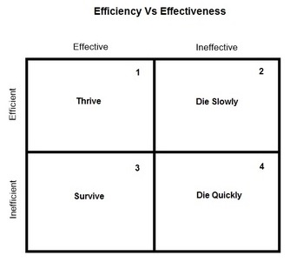
A False Trade-off: Efficiency vs Quality
Current Trends in HIV Care
Decentralisation, self-care, longer refill intervals
Fewer contacts, reduced monitoring
"One-size-fits-all" for a complex epidemic
Simplification becomes a risk when it erodes care quality
The pursuit of efficiency has created a false dichotomy between service delivery speed and quality of care. Uniformity in approach fails to address the complexity of individual patient needs.

Slide 4
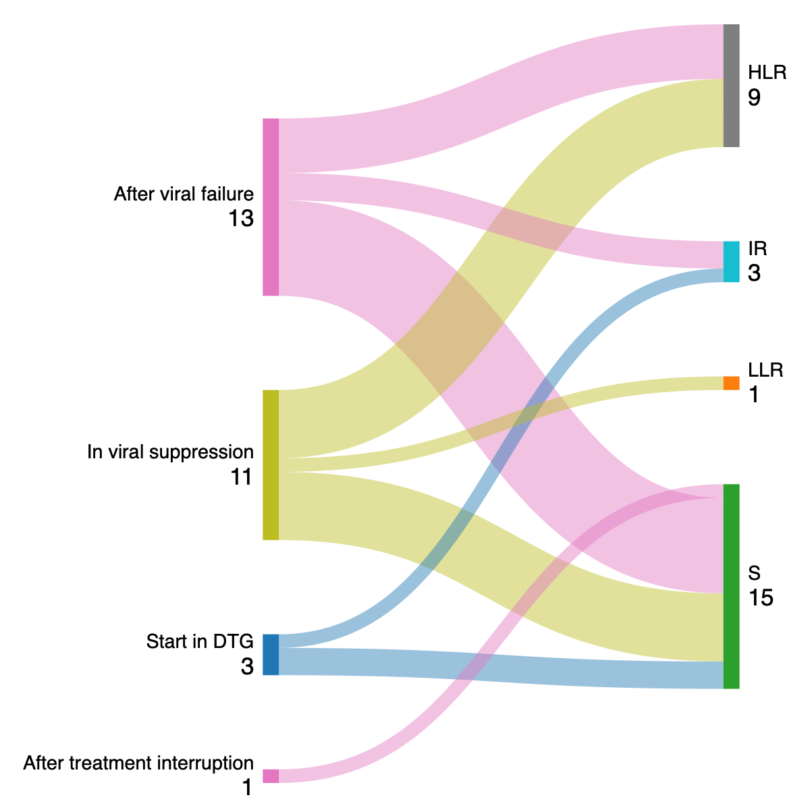
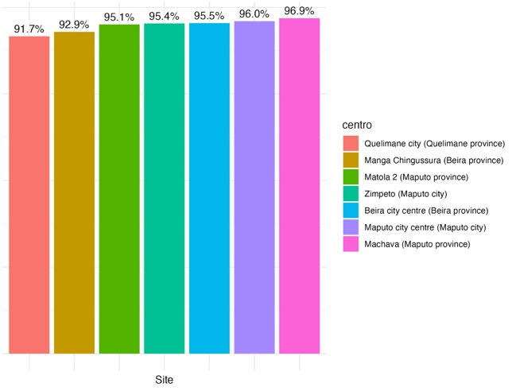
Viral failure and DTG resistance in a Mozambican cohort
29.051 Mozambican patients in DTG:
VL control in 91,7 – 96,9%
Among 28 patients tested for DTG resistance:
13 DTG resistance detected

Slide 5
DTG Resistance: The Warning Bell
Dolutegravir resistance is emerging as a critical concern, but we must understand it as more than just a clinical issue:
Not just a clinical concern
A systemic red flag
The emergence of DTG resistance represents a failure of our monitoring and support systems
Signals deeper problems in our service delivery models and highlights gaps in quality assurance
Reflects fragmentation
Poor monitoring, weak follow-up, and inadequate patient support create conditions for resistance

Slide 6
Systemic Fragilities: Examples from the Field
HIV self-testing without counselling or follow-up
Medication dispensed by rotating, unfamiliar staff
Patients receive diagnoses without support systems in place to process information or connect to care
Loss of provider-patient relationship and continuity of care
Annual visits with minimal assessment
Disconnected, impersonal services
Long gaps between assessments miss early warning signs of treatment failure
Leading to what we might call the "lonelinization" of HIV care
Result: Isolation and silent failures (Die slowly)

Slide 7
Evidence of Systemic Risks:
The Cost of Impersonalised HIV Services
Risk Area
Evidence
Implications
Emotional harm from self-testing
Spyrelis et al. (2017): Suicidal ideation in men using HIV self-tests without counselling
Psychological crisis without support
Poor linkage to care
Lebina et al. (2019): Self-test users in Malawi didn't link to services despite follow-up
Delayed treatment initiation
Delayed disclosure
Sethosa & Peltzer (2005): Only 36% disclosed status within 5 months
Lack of support networks
Provider training issues
Kapologwe et al. (2011): 1/3 of providers failed to offer HIV testing
Inconsistent care delivery
Loss to follow-up
Namuwenge et al. (2012): 58% LTFU rate for IPT in Uganda
Treatment interruption

Slide 8
Evidence of Systemic Risks:
The Cost of Impersonalised HIV Services
Risk Area
Evidence
Implications
Emotional harm from self-testing
Spyrelis et al. (2017): Suicidal ideation in men using HIV self-tests without counselling
Psychological crisis without support
Poor linkage to care
Lebina et al. (2019): Self-test users in Malawi didn't link to services despite follow-up
Delayed treatment initiation
Delayed disclosure
Sethosa & Peltzer (2005): Only 36% disclosed status within 5 months
Lack of support networks
Provider training issues
Kapologwe et al. (2011): 1/3 of providers failed to offer HIV testing
Inconsistent care delivery
Loss to follow-up
Namuwenge et al. (2012): 58% LTFU rate for IPT in Uganda
Treatment interruption
Contrasting the isolation of patients, not only an ethical issue, but a strategic one

Slide 9
The evolution of African Context: complexity

Slide 10
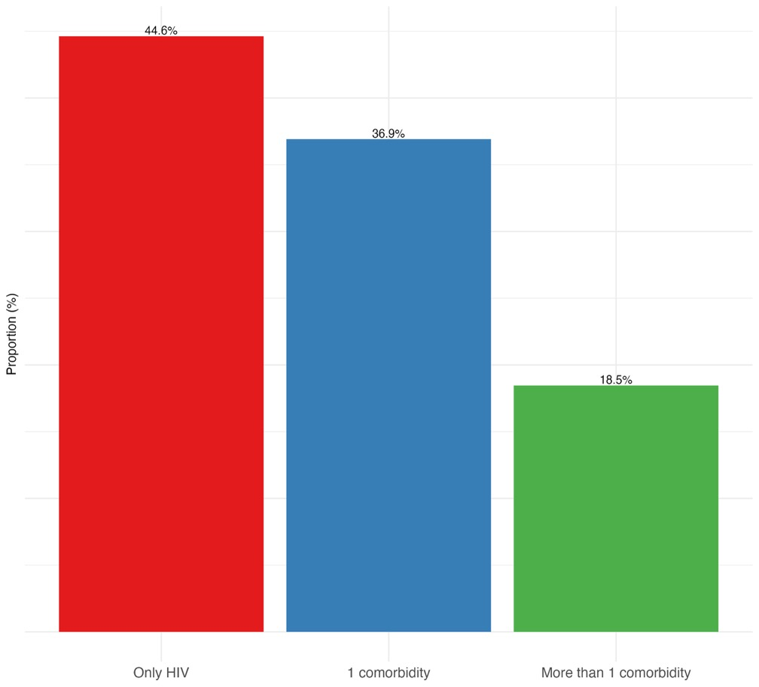
The evolution of African Context: complexity
Ciccacci, Fausto, et al. "Noncommunicable diseases burden and risk factors in a cohort of HIV+ elderly patients in Malawi." AIDS Research and Human Retroviruses 35.11-12 (2019): 1106-1111.
Ciccacci, Fausto, et al. "Exploring diseases burden in HIV population: Results from the CHAO (Comorbidities in HIV/AIDS outpatients) cross-sectional study in Kenya." Global Epidemiology 8 (2024): 100174.

Slide 11
The Public Health Response: Four Strategic Pillars
Routine Resistance Testing
Community Engagement
Integration of resistance monitoring into standard care protocols
Rebuilding support networks and human connections in care delivery
DSD
Expanded Treatment Options
Person-centered care that evolves beyond simplified models to address individual needs
Ensuring access to alternative regimens when resistance emerges

Slide 12
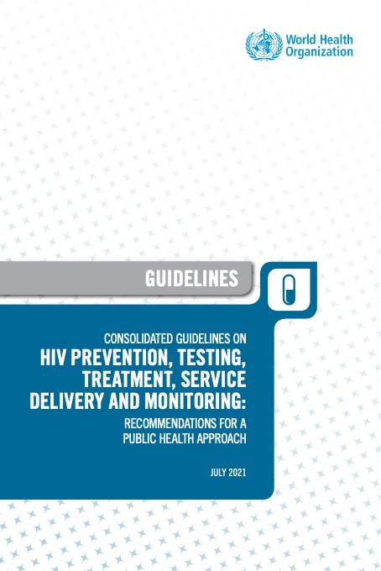
Pillar 1: DSD – Tailored, Not Simplified
Moving Beyond Binary Classification
Current differentiated service delivery (DSD) models often categorise patients simply as "stable" or "unstable," overlooking crucial nuances in their care needs.
DSD requires us to account for:
Age-specific considerations
Presence and severity of comorbidities
Psychosocial needs and support systems
Treatment history and adherence patterns
Flexibility, not rigidity
Individual preferences and literacy levels
Services must adapt to individual needs rather than forcing patients to fit predefined pathways

Slide 13
Pillar 2: Resistance Testing – From Surveillance to Routine
EACS guidelines: «Genotypic resistance testing is recommended prior to initiation of ART, ideally at the time of HIV diagnosis.»
DHHS guidelines: «HIV drug-resistance testing is recommended at entry into care for people with HIV to guide the selection of the initial antiretroviral (ARV) regimen-»

Slide 14
Pillar 2: Resistance Testing – From Surveillance to Routine
EACS guidelines: «Genotypic resistance testing is recommended prior to initiation of ART, ideally at the time of HIV diagnosis.»
DHHS guidelines: «HIV drug-resistance testing is recommended at entry into care for people with HIV to guide the selection of the initial antiretroviral (ARV) regimen-»
WHO guidelines: «In settings or populations in which DTG is not accessible or unsuitable … if feasible, HIV drug resistance testing can be considered to guide the selection of first-line ART regimen»

Slide 15
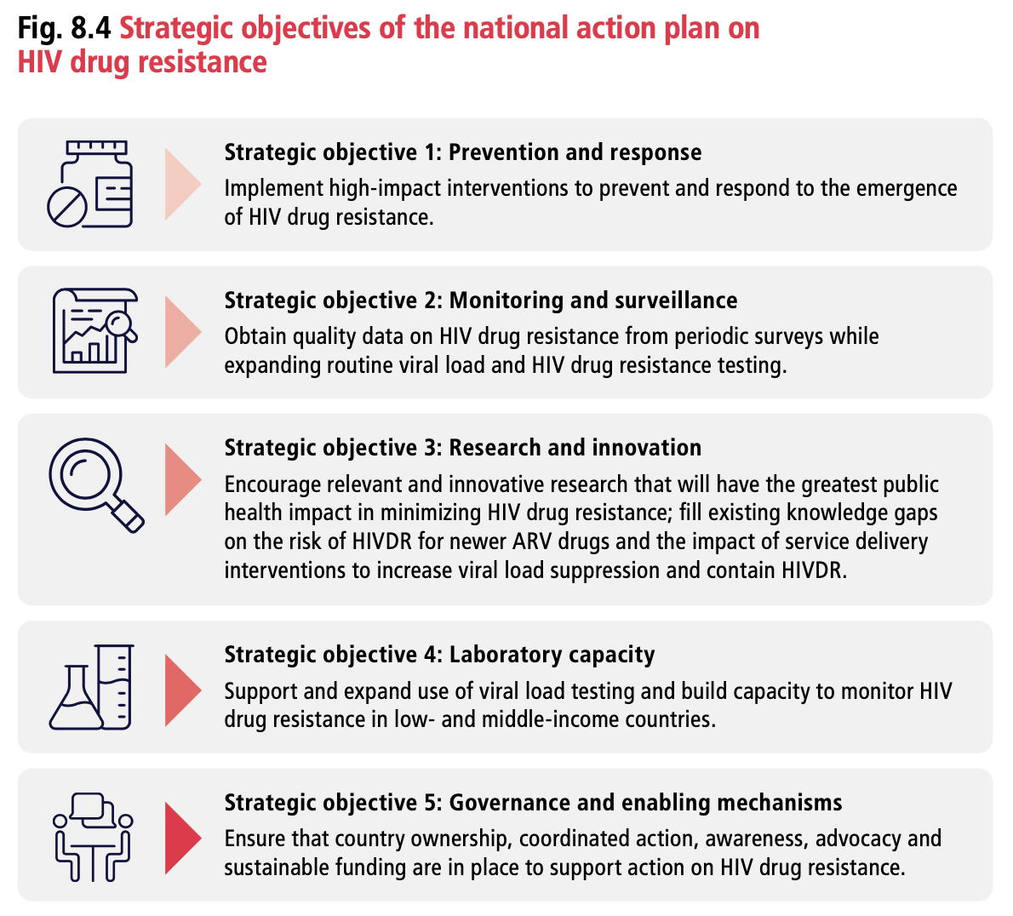
Pillar 2: Resistance Testing – From Surveillance to Routine
EACS guidelines: «Genotypic resistance testing is recommended prior to initiation of ART, ideally at the time of HIV diagnosis.»
DHHS guidelines: «HIV drug-resistance testing is recommended at entry into care for people with HIV to guide the selection of the initial antiretroviral (ARV) regimen-»
WHO guidelines: «In settings or populations in which DTG is not accessible or unsuitable … if feasible, HIV drug resistance testing can be considered to guide the selection of first-line ART regimen»

Slide 16
Pillar 2: Resistance Testing – From Surveillance to Routine
EACS guidelines: «Genotypic resistance testing is recommended prior to initiation of ART, ideally at the time of HIV diagnosis.»
DHHS giudelines: «HIV drug-resistance testing is recommended at entry into care for people with HIV to guide the selection of the initial antiretroviral (ARV) regimen-»
We need resistance testing in clincal care in Africa, too!!
WHO guidelines: «In settings or populations in which DTG is not accessible or unsuitable … if feasible, HIV drug resistance testing can be considered to guide the selection of first-line ART regimen»

Slide 17
Pillar 3: Community Engagement
People, Not Just Pills
Community engagement is not an optional add-on but a core component of effective HIV care. It provides the human element that simplified models often sacrifice.
Essential Community Structures:
Peer educators who understand the lived experience of HIV
Support groups that reduce isolation and stigma
Community health workers who bridge clinical and home environments
Treatment literacy campaigns that empower patients
Family support systems that improve adherence
These structures reduce isolation, improve retention in care, and create accountability systems that prevent silent treatment failure.
Rebuild human connection

Slide 18
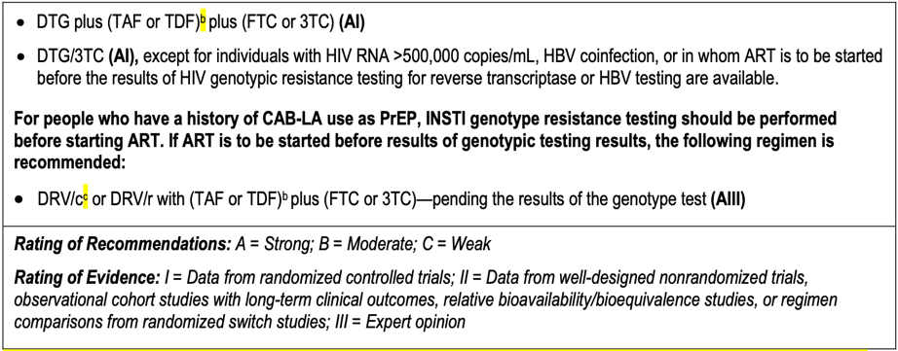
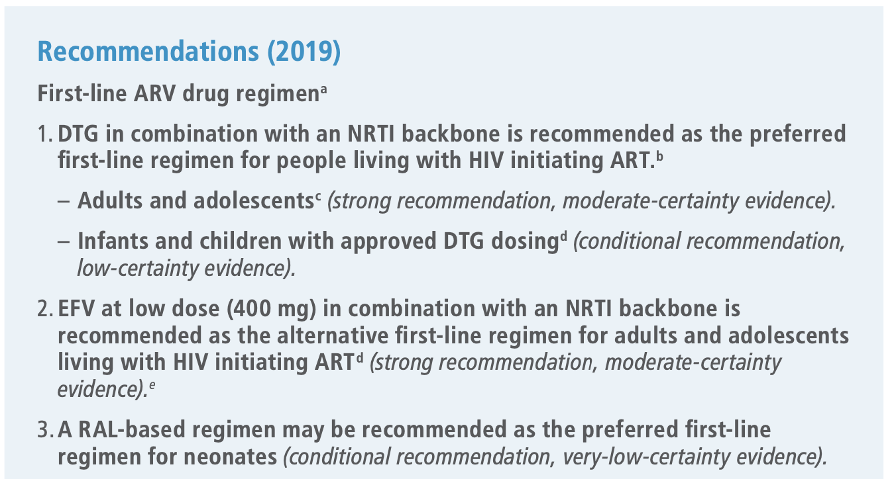
Pillar 4: More Therapeutic Options
True DSD Requires Choice!
DHHS
EACS
WHO

Slide 19
Pillar 4: More Therapeutic Options
True DSD Requires Choice!
DHHS
EACS
We need more therapeutic options in Africa, too!!
WHO

Slide 20
More Than Resistance – A Stress Test for the System
The emergence of dolutegravir resistance is revealing fundamental weaknesses in our HIV service models:
This challenge presents an opportunity to reimagine HIV care delivery that truly addresses the needs of people living with HIV, respects the complexity of their lives, and ensures equitable access to the best possible care regardless of geography.
Silent failures are growing beneath the surface of reported successes
Fragmentation and depersonalisation weaken
long-term outcomes
Current models may not be sustainable as epidemiology evolves
Let's make HIV services person-centred, context-aware, and globally fair

Slide 21
Conclusion
The history of HIV has shown that minimalism is not the way

Slide 22
Conclusion
The history of HIV has shown that minimalism is not the way
The emergency of DTG resistance is highlighting concerns in current public health strategies

Slide 23
Conclusion
The history of HIV has shown that minimalism is not the way
The emergency of DTG resistance is highlighting concerns in current public health strategies
A new minimalism risk to waste the global efforts made in the last 25 years

Slide 24
Conclusion
The history of HIV has shown that minimalism is not the way
The emergency of DTG resistance is highlighting concerns in current public health strategies
A new minimalism risk to waste the global efforts made in the last 25 years
We propose to act firmly to develop new services based on:
real DSD,
resistance testing in clinical routine,
stronger involvement of the communities,
availability of more therapeutic (not preventive!) options

Slide 25
Thank you

