Slide 1
LESSONS LEARNED DREAM PROGRAM IN MALAWI
Dr HAWA MAMARY SANGARE

Slide 2
From DREAM to DREAM 2.0
Drug resource enhancement against aids and malnutrition (DREAM)
Notes:
Dream started as HIV and malnutrition care institution as we both are immune suppressed conditions under Dream , Drug Resource Enhancement against Aids and Malnutrition
Then in 2015 Dream became a global health care institution covering communicable and none know communicable diseases under Dream2.0 , Diseases Relief Through Excellent and Advanced Means.

Slide 3
From DREAM to DREAM 2.0
Drug resource enhancement against aids and malnutrition (DREAM)
Diseases Relief Through Excellent and Advanced Means (DREAM 2.0)
Notes:
Dream started as HIV and malnutrition care institution as we both are immune suppressed conditions under Dream , Drug Resource Enhancement against Aids and Malnutrition
Then in 2015 Dream became a global health care institution covering communicable and none know communicable diseases under Dream2.0 , Diseases Relief Through Excellent and Advanced Means.

Slide 4
DREAM in Africa – key data since 2002
50 health centres across 10 countries
28 molecular biology laboratories
562,000 people assisted– including 103,000 children under 15
>10 million medical visits delivered
4,3 million laboratory tests performed
Over 148,000 vaccinations administered
Notes:
Malawi is one of the 1o countries where Dream oparates

Slide 5
Dream in Malawi
Started operations in 2004
Present in 15 health facilities
Running three molecular laboratories
All services are free of charge

Slide 6
Background in Malawi
HIV & related diseases from 2004
Telemedicine from 2015
Dream Women Health cancer program started in 2016 with combined cervical cancer and breast cancer screening clinics.
Epilepsy from 2020
Audiology from 2021
Breast cancer stand alone clinic with echo scanning in 2021
HPV DNA testing in 2022
HPV vaccination for girls 9-14 years old in 2022
Notes:
DREAM (Drug Resource Enhancement against Aids and Malnutrition) to Dream 2.0 ( Disease Relief through Excellent and Advanced Means)

Slide 7
The key elements
Patient centered- care
Free treatment and care
Prevention therapy
Laboratory diagnostics
Innovation
Setting up a system of excellence
Continuous Professional Development & Research

Slide 8
Expandend Services provided by DREAM
Services Provided
📊 Health Services Impact Highlights
Epilepsy diagnosis and care
Audiology
Cervical cancer prevention (HPV vaccination & screening)
Breast cancer screening
Diagnosis and treatment of TSIs
Tuberculosis care
Cardiovascular disease management
Diabetes care
Telemedicine support
> 230,000 HIV patients actually in care
🎗️ 16,500 HPV vaccinations
🔬 > 86,000 HPV screenings
🩺 3,500 breast cancer screenings (Malawi – ultrasound)
🫁 > 21,000 TB patients followed
🍬 > 9,200 diabetes patients
❤️ 56,000 hypertension patients
⚡ > 2,200 epilepsy patients
Notes:
90/70/90 cervical cancer elimination goals by 2030

Slide 9
DREAM Laboratory Services & Impact
🔹 Diagnostic Services Provided
📊 Key DREAM Laboratory Achivements
HIV-1 Viral Load
Tubercolosis (GeneXpert)
Haematology
Biochemistry
Early Infant Diagnosis (EID-HIV)
CD4 count
COVID-19 diagnosis
HIV Drug Resistance (HIVDR)
Malaria diagnosis
Crypyococcal Antigen (CrAg)
Others (e.g. urinalysis, blood cultures)
🧪 ~ 2 million HIV-1 viral load tests
🔬 1,3 million CD4 count tests
🩸 1,9 million haematology tests
🧫 > 4,000 molecular tubercolosis tests (GeneXpert)
Notes:
Importance of CD4 and VL in HIV patient management

Slide 10
Key success in HIV care
EMTCT consistently <1%
Retention in care:
92% to 95%
Well established HIV & NCDschampions
Notes:
How ?
-Friendship as service providers attitude toward client has impact on treatment outcomes. Stigma in H/C and community
-Community awareness, testing , screening and care
-Expert clients
Youth ,men and women champion including community leaders

Slide 11
Differentiated Services Delivery (DSD) for HIV+ adolescents
Central Africa
Mozambique
Malawi
Cameroon
Teen Club for HIV pts
epileptics patients
diabetic patients
English classes
football match
computer training
weekly meeting with HIV pts

Slide 12
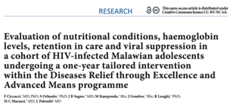
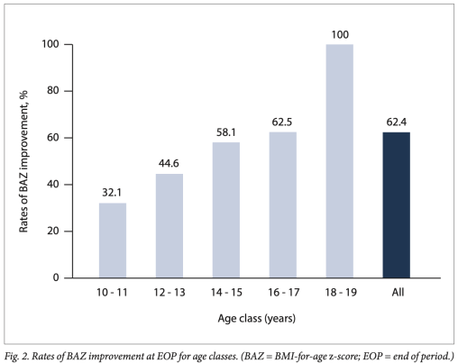
Differentiated Services Delivery (DSD) for HIV+ adolescents
Malawi:
425 HIV+ patients aged 10-19 years
DREAM Centre Blantyre
Since December 2016, specific service for adolescents:
Special day for teenagers
Involvement of youth leaders (peer-to-peer)
Non-clinical activities included in the center (theater, teen clubs, etc.)
After 1 year from the start of service:
Retention in care 94.8%
50.6% improved nutritional status (BAZ) (70.2% of initially malnourished patients)
79.0% had VL undetectable
«Data from the DREAM program shows the effectiveness of
a public health approach to HIV-positive adolescents ' health in
Malawi. The results in terms of nutritional rehabilitation , HGB
level increase , retention in care, and viral suppression highlight that
specific adolescent -friendly interventions are urgently needed to
reduce the burden of HIV infection in African teenagers ..»

Slide 13
Challenges
Insufficient awareness to overcome stigma and discriminations
Reaching and re-engaging who is lost
Emerging cases of drug resistance

Slide 14
Tailored services for specific patients’ group

Slide 15
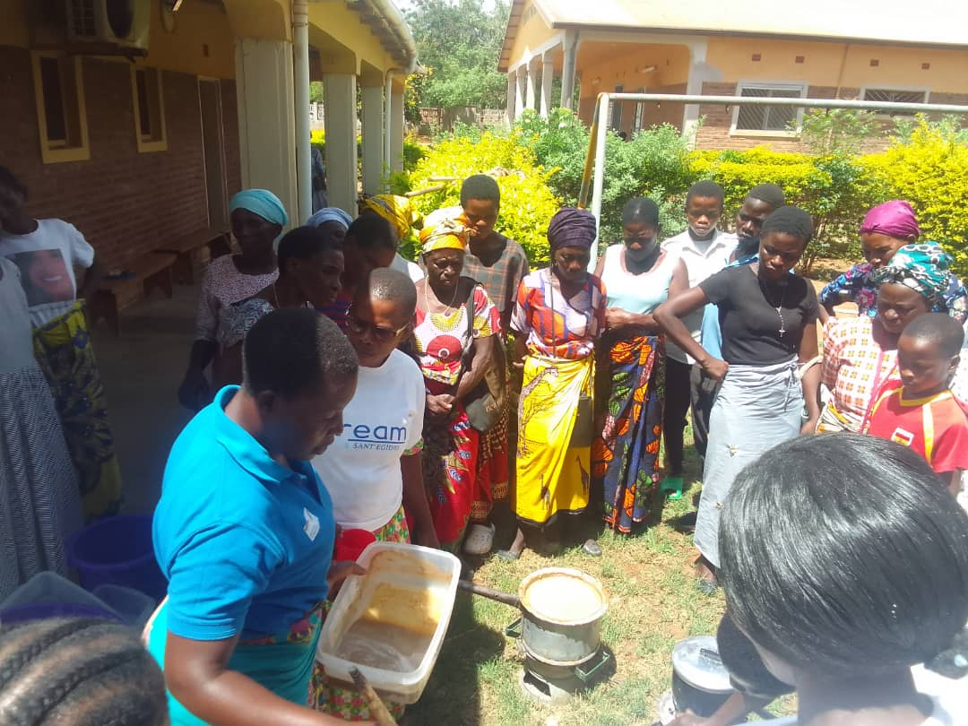
Notes:
-EMTC mother group food cooking demonstration emphasizing the use of foods that are grown or found locally, making healthy eating accessible and sustainable for the communities.
- Also use as a means of boosting incomes EX: soya milk business

Slide 16
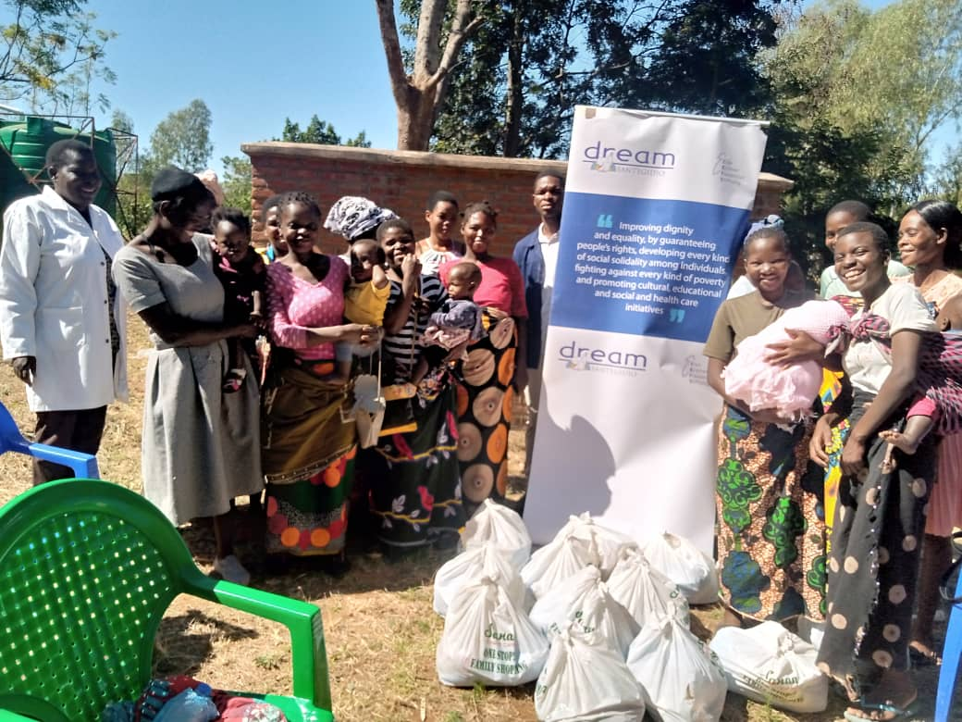
Notes:
Mentor support group

Slide 17
Notes:
Religious leaders male champions orientation

Slide 18
Notes:
Male clinic

Slide 19
Notes:
Youth champions Cervical cancer awareness football competition

Slide 20
Notes:
Mobile awareness,

Slide 21
Notes:
Community awareness

Slide 22
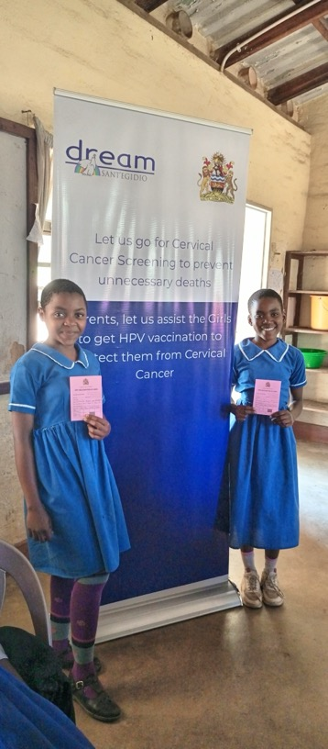
HPV Vaccination

Slide 23
Molecular labs-accreditation
Notes:
Laboratory accrediation

Slide 24
Lessons learnt
It is possible to deliver high quality healthcare in resource-limited settings and to achieve excellent results
More complex ,yet ultimatly more effective interventions prove to be most successful in long term
The intervention has to be continuously adapted as the epidemic change
Investing in people is the key for a sustainable success

Slide 25
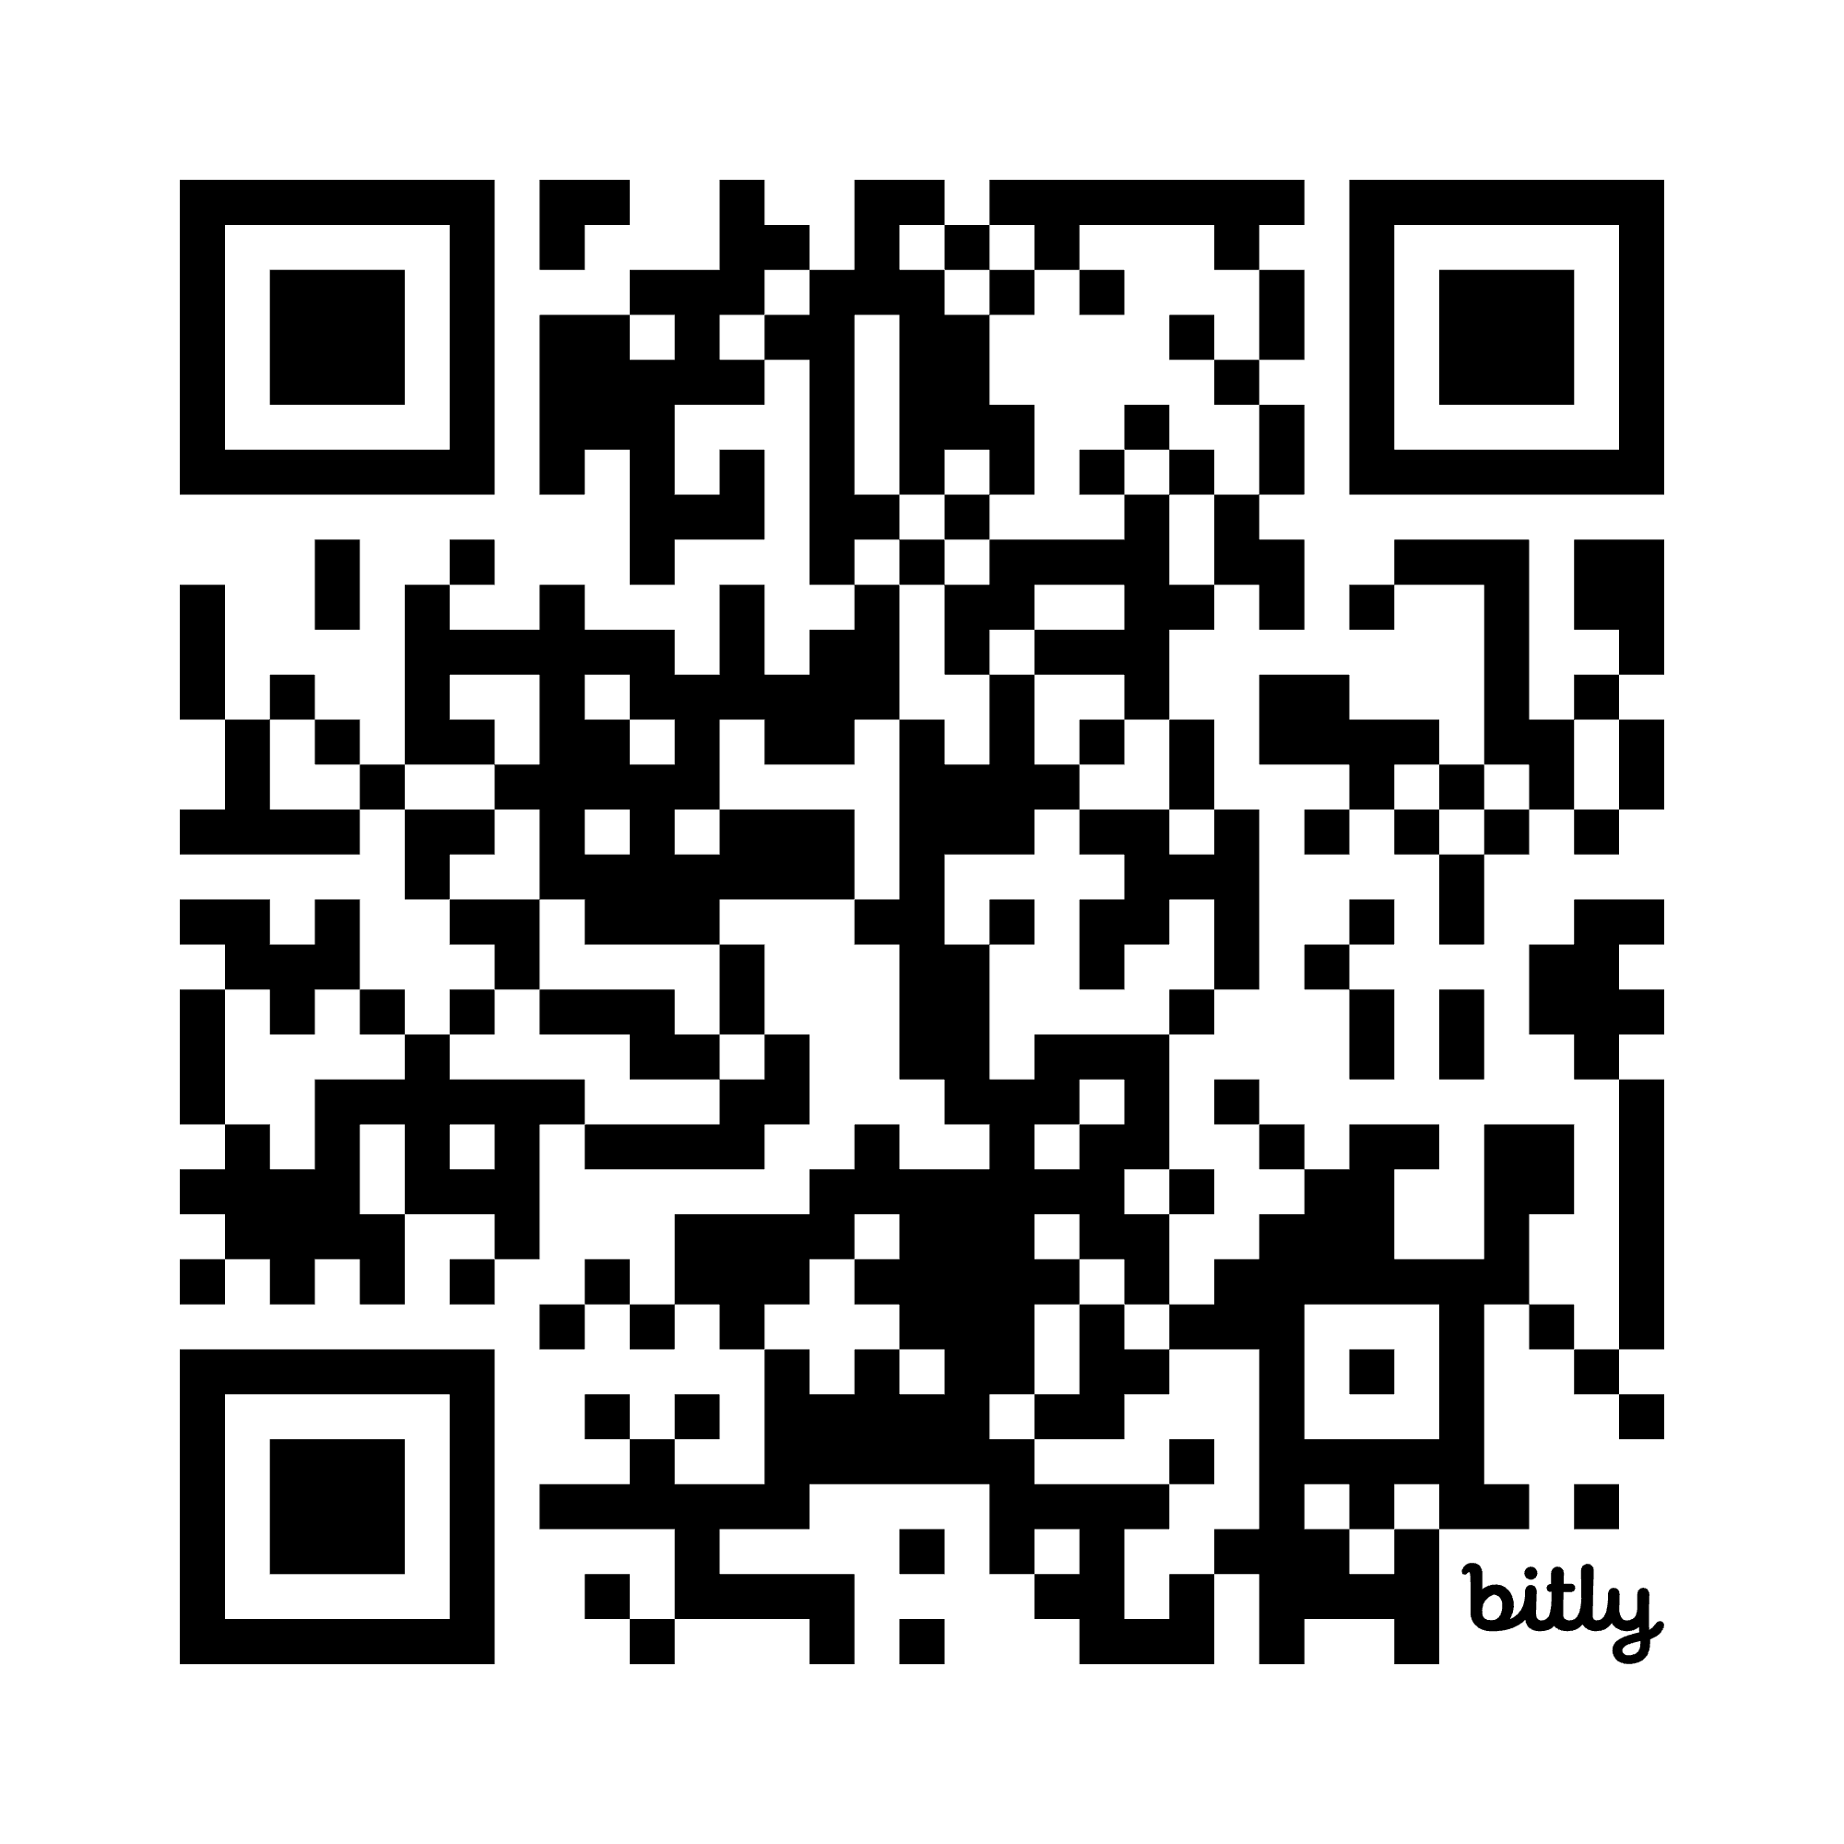
Thank you for your attention

