Slide 1
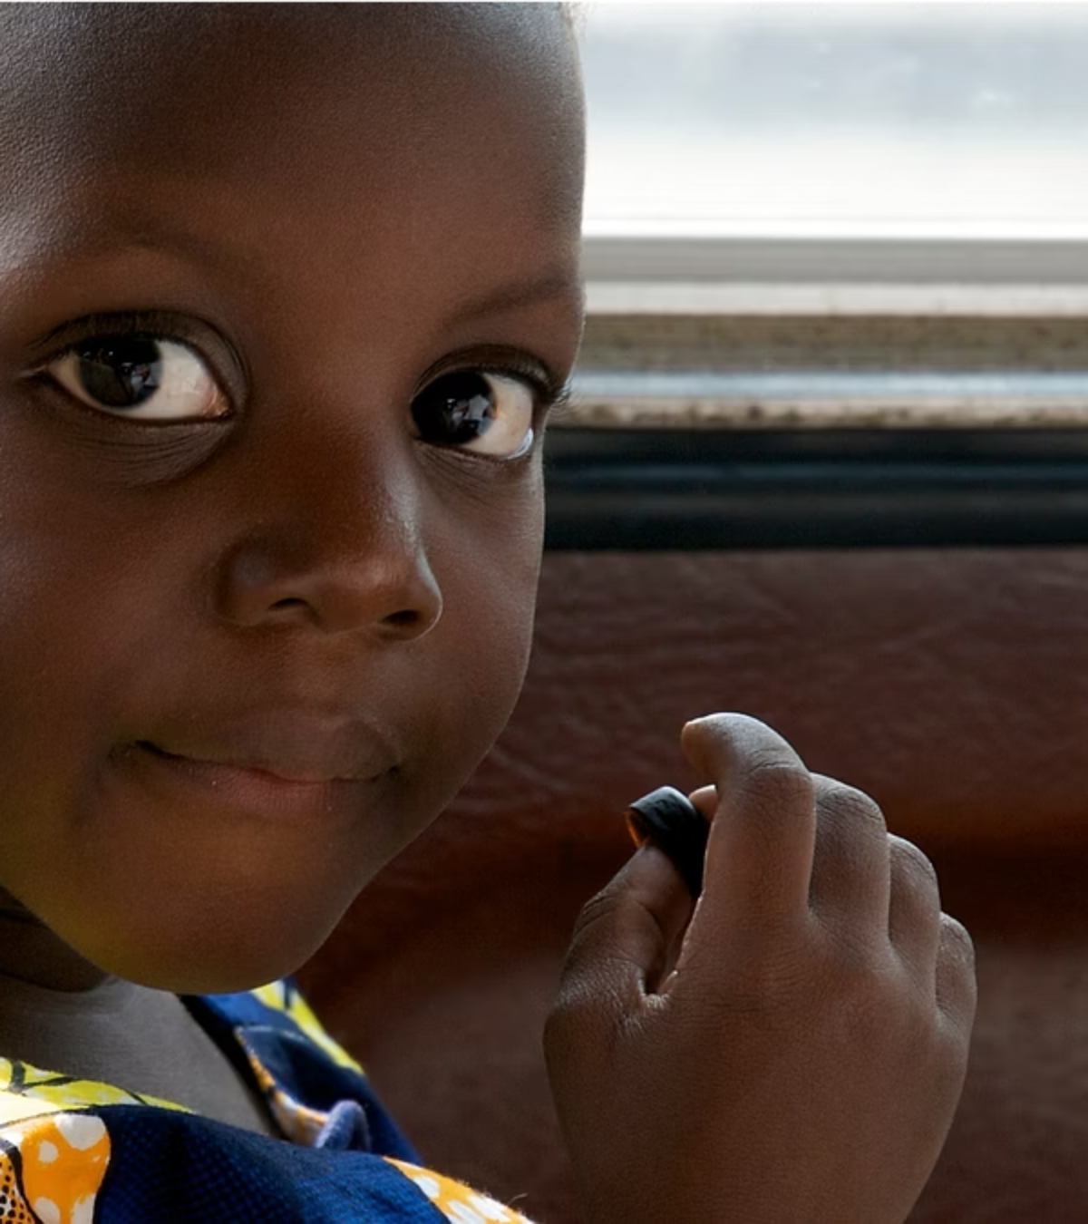
The Global Response to HIV/AIDS in Sub-Saharan Africa
Achievements, Challenges, and Perspectives for the Future
Prof. Stefano Orlando
Notes:
Aggiungere loghi

Slide 2
Historical Context: Milestones in the Global Response
1995-1996
Peak HIV incidence (3.3M new infections). UNAIDS established. Introduction of combined Antiretroviral Therapy (ART), transforming HIV into a manageable chronic condition.
2010-2014
Global ART coverage rises from 24% to higher levels. UNAIDS establishes 90-90-90 targets to end AIDS epidemic as a public health threat.
1
2
3
4
2002-2003
2023
Creation of The Global Fund to fight AIDS, TB and malaria. Launch of PEPFAR (President's Emergency Plan for AIDS Relief), one of the largest international health initiatives.
ART coverage reaches 77% globally. 86% of PLHIV know their status, 89% of those diagnosed on ART, and 93% of those on treatment achieving viral suppression.
AIDS represents the first disease in history that prompted a coordinated global response proven highly effective, with an estimated 65-100 million lives saved globally.

Slide 3
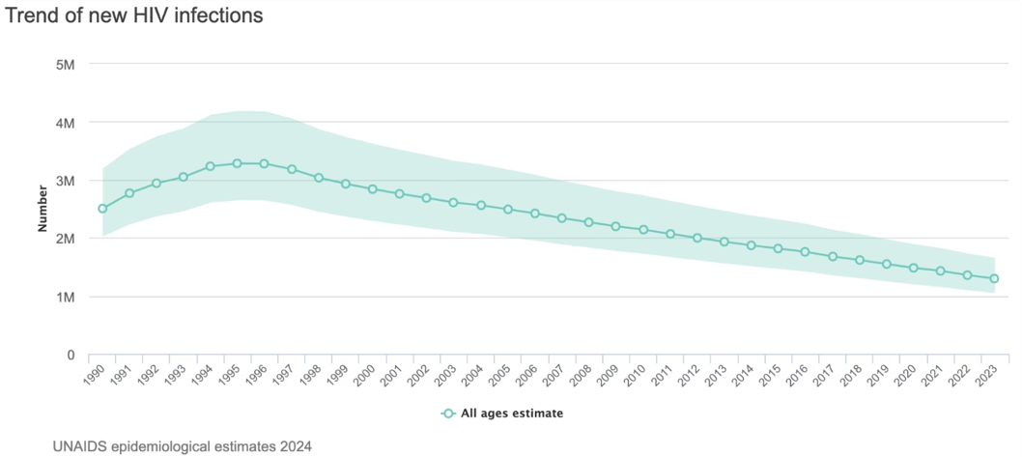
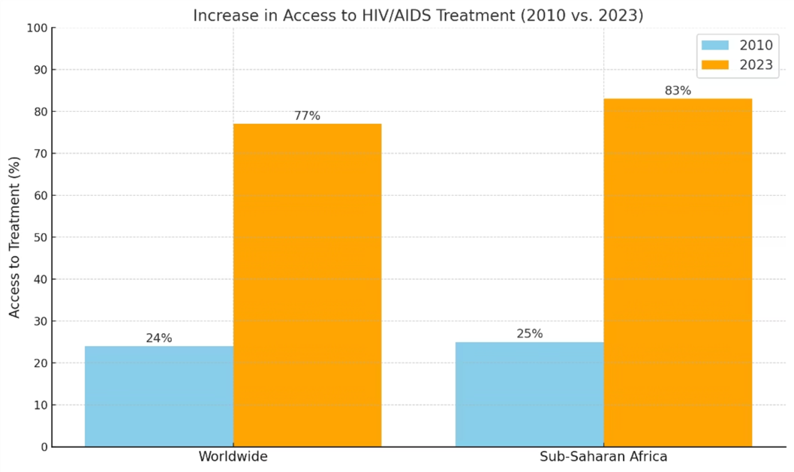
The global response – access to treatment

Slide 4
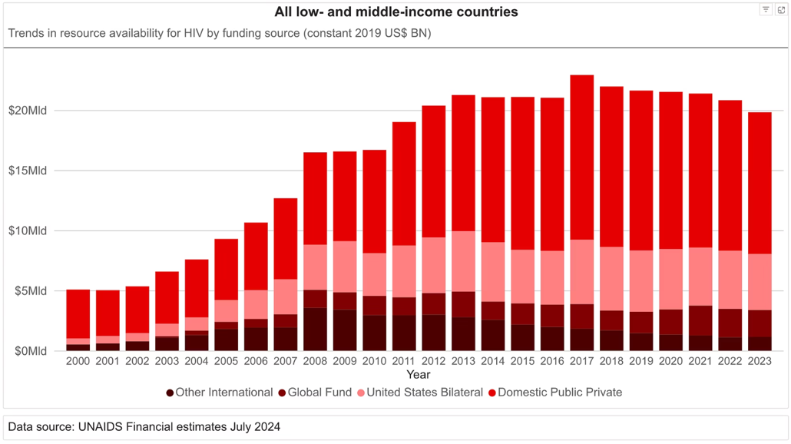
Economic Resources and Health System Strengthening
Since 2010, funding for AIDS response in low- and middle-income countries has consistently reached approximately 20 billion USD annually, Benefits extend beyond HIV/AIDS-specific interventions:
Recruitment, training, and retention of health professionals
Mitigation of brain drain in healthcare
Infrastructure investments establishing molecular laboratories
Improved diagnostic and treatment capabilities across health conditions

Slide 5
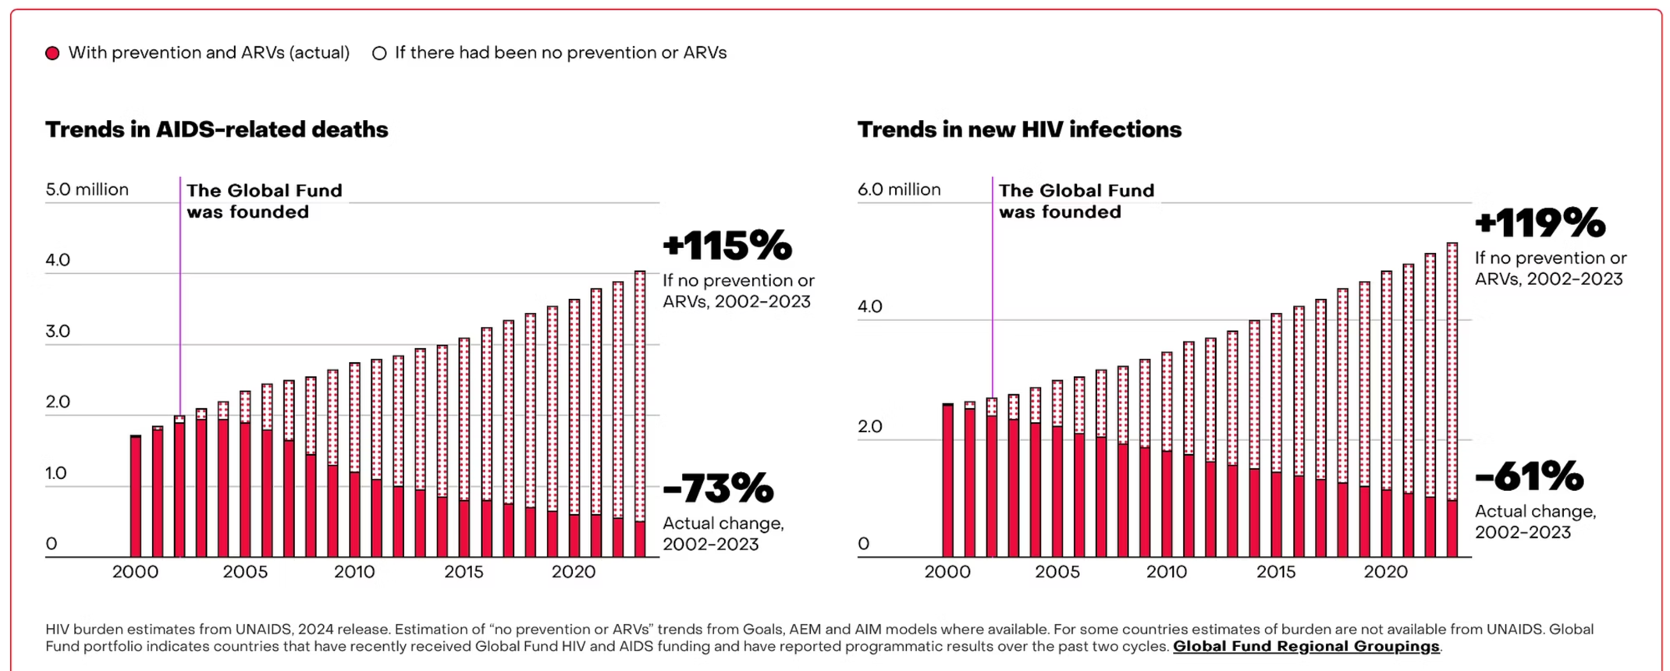
Global Fund projections
100 millions of lives saved

Slide 6
HIV Expenditure in African Countries
The scale of investment in HIV programs varies widely across countries due to local economic conditions and health system infrastructure.
Country
HIV expenditure over Health Expenditure
HIV expenditure over Public Health Expenditure
HIV expenditure over GDP
Malawi
24.19%
127.84%
1.79%
Mozambique
29.25%
102.38%
2.66%
Uganda
23.51%
100.46%
1.11%
Zambia
24.16%
56.95%
1.59%
Kenya
15.72%
32.15%
0.71%
Malawi serves as a remarkable case study: HIV/AIDS interventions amount to approximately 127% of the country's entire public health expenditure and nearly 2% of its national GDP.

Slide 7
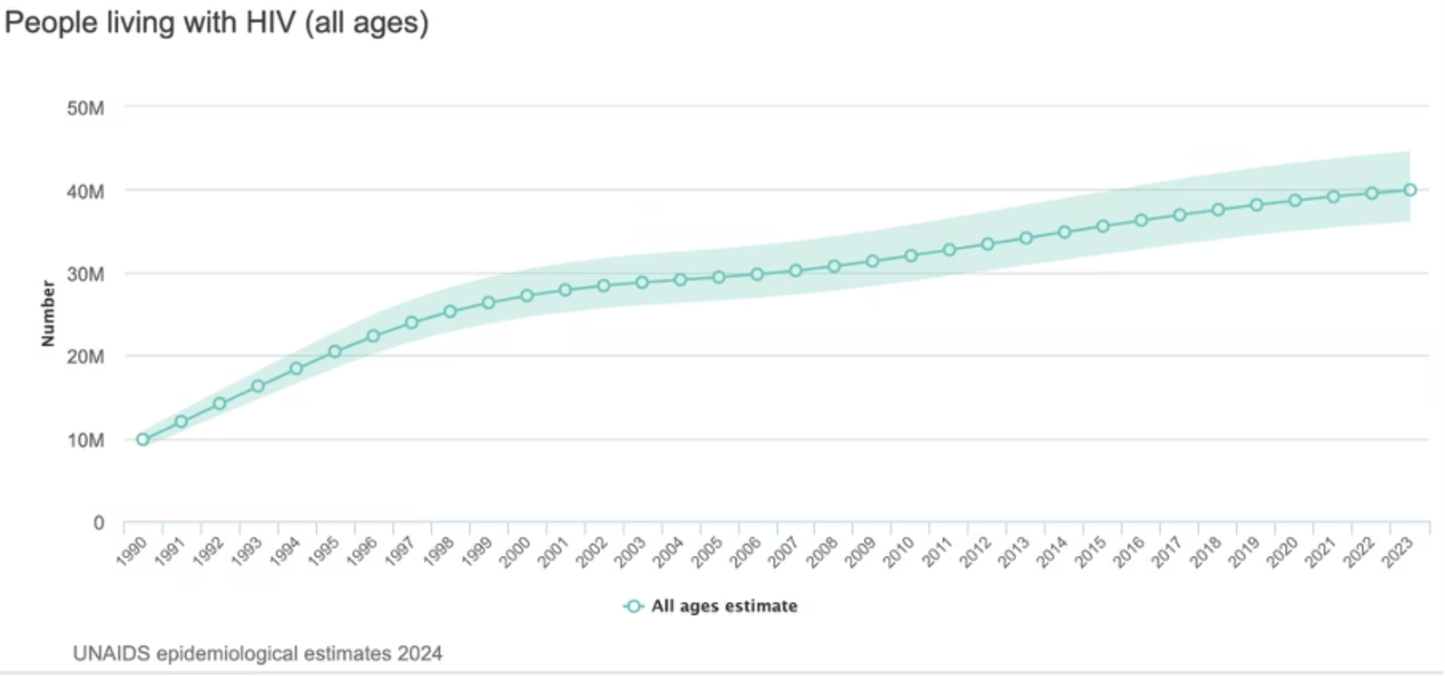
Current Challenges: The Epidemic Persists
Growing Numbers Despite Progress
1
While adult HIV prevalence has plateaued globally at approximately 0.7%, this figure remains higher than in 1996 (0.6%). The absolute number of people living with HIV continues to rise, with 39.9 million people living with HIV globally in 2023—an increase of 400,000 from the previous year.

Slide 8
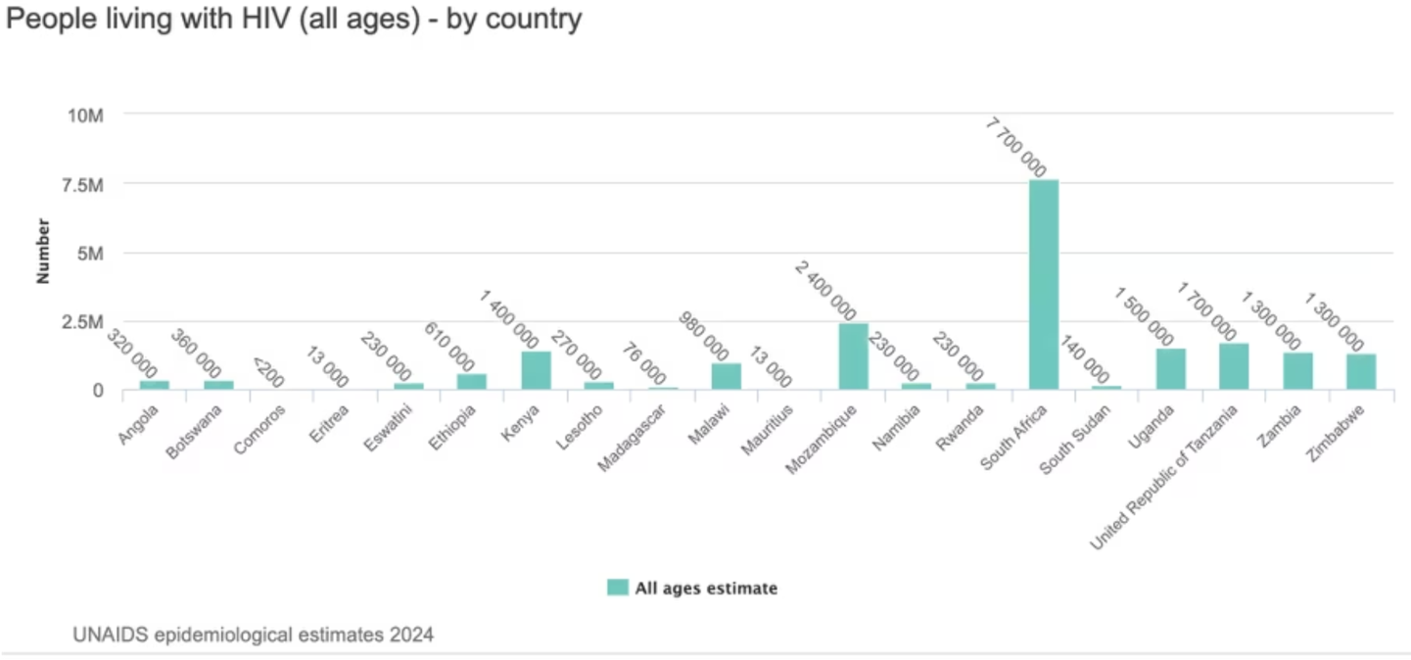
The health and financial high-burden
High-burden countries
Financial sustanaibility
In several countries—Kenya, Mozambique, South Africa, Uganda, Tanzania, Zambia, and Zimbabwe—the number of people living with HIV exceeds one million, underscoring the continued severity of the epidemic in the region.
In Mozambique, where approximately 2.4 million people are living with HIV, the annual financial requirement to sustain HIV care exceeds USD 600 million, or roughly 3% of the country's GDP—more than the entire health sector currently receives.

Slide 9
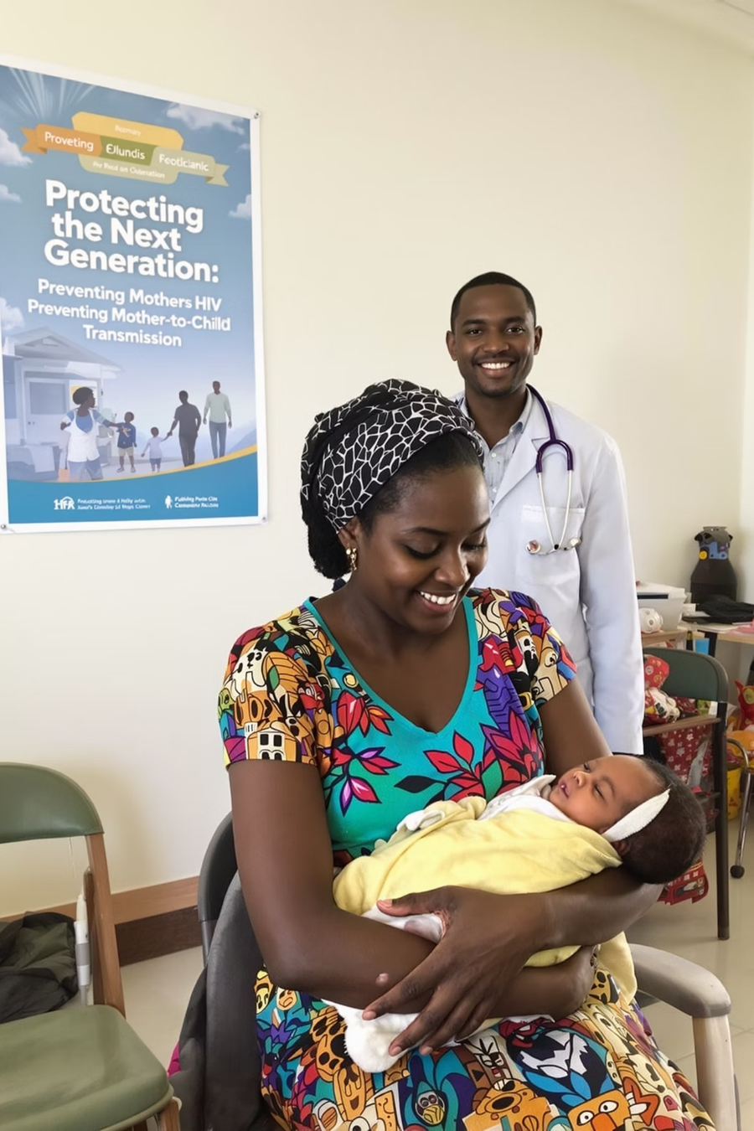
Prevention Challenges: Mother-to-Child Transmission
Prevention of mother-to-child transmission (PMTCT) has seen significant success in many parts of the world, with some regions reaching the "Getting to Zero" target for children born with HIV.
However, critical gaps remain in high-burden countries:
In Guinea, the vertical transmission rate remains as high as 20%
In Mozambique, it hovers around 10%
The number of children aged 0–14 living with HIV in Mozambique alone is still estimated at 150,000
These figures highlight critical gaps in the implementation and scale-up of PMTCT programs in certain contexts.

Slide 10
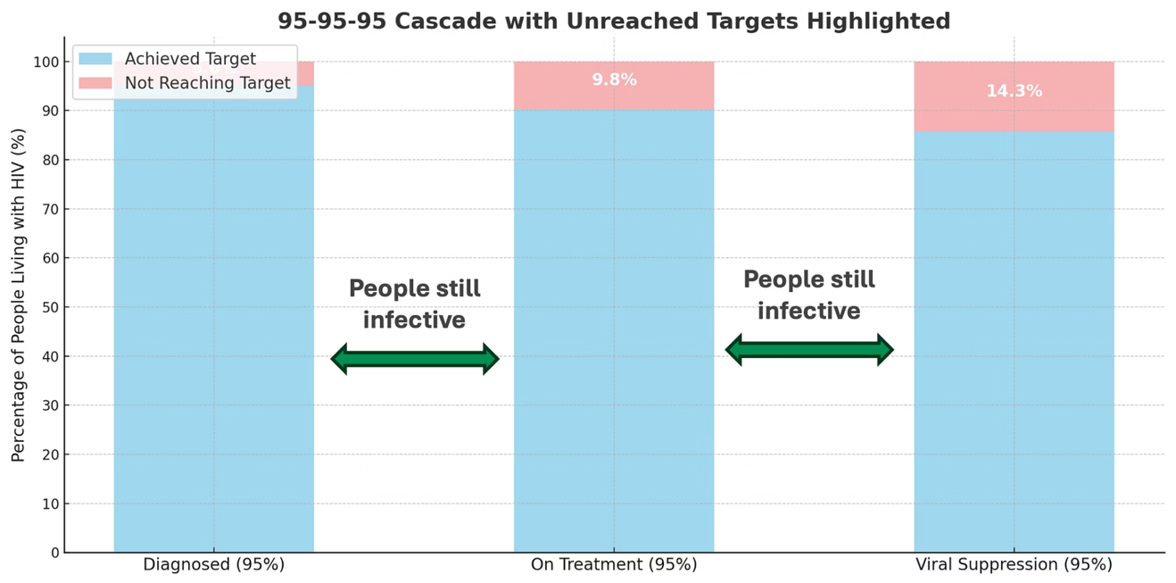
95-95-95 means 14.3% people with HIV not on treatment
Late Diagnosis Challenges
Many individuals only receive a diagnosis once AIDS has progressed to an advanced stage. In Kenya and Malawi, 9.7% of people newly diagnosed had late-stage disease, rising to 15.3% among men, highlighting gender disparities in healthcare access.

Slide 11
Innovations in HIV Prevention:
The Promise and the Challenge of Long-Acting PrEP
Significant Barriers Remain
Access & Adherence: Despite the innovation, significant barriers persist, particularly for vulnerable and marginalised populations. These include adolescent girls and young women (AGYW), men who have sex with men, sex workers, and people who inject drugs.
Cost Disparity: The potential cost is a major challenge. While Gilead Sciences announced a US list price of $28,218 USD per person per year for lenacapavir, research suggests generic versions could cost $35-$46 per person-year.
The introduction of Pre-Exposure Prophylaxis (PrEP) has been a significant breakthrough in HIV prevention. Recent advancements include long-acting formulations, such as biannual injectable agents like lenacapavir, offering a promising new avenue to reduce HIV incidence among at-risk populations.

Slide 12
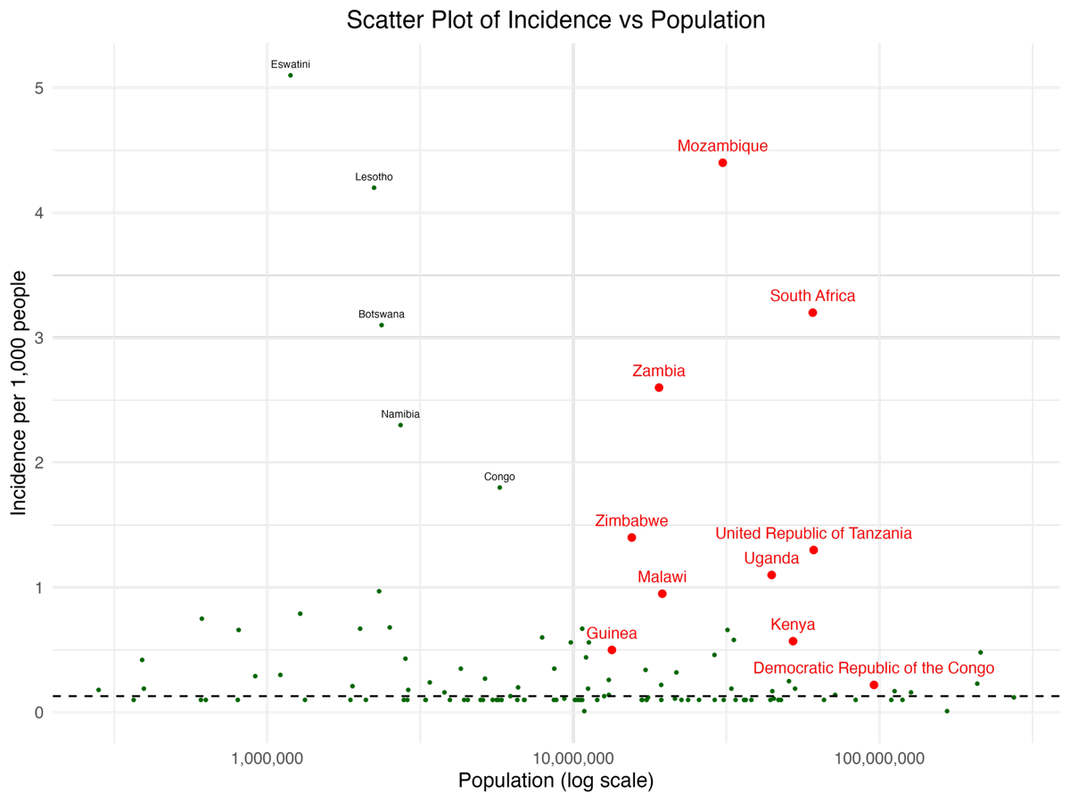
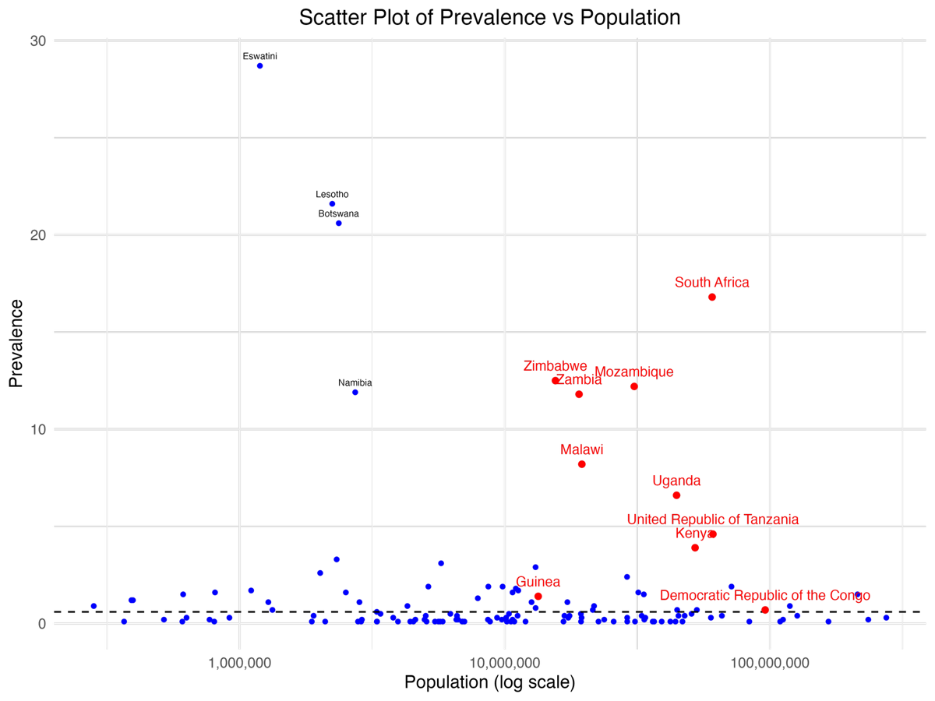
Between countries inequalities

Slide 13
Vulnerable Populations: Disproportionate Impact
Adolescent Girls and Young Women
Children Under 14
In sub-Saharan Africa, HIV infection incidence among AGYW increased to four out of five new infections, compared to three out of five in 2017.
Children below 14 have a 35% lower HIV testing, treatment initiation, and suppression rate compared to older individuals.
Rural Communities
Key Populations
Geographic isolation, weak health systems, and limited surveillance create barriers to diagnosis and treatment in rural areas.
Sexual minority men, sex workers, people who inject drugs, transgender individuals, and prisoners face overlapping challenges related to stigma, discrimination, and criminalization.
Systemic inequalities worldwide, such as socioeconomic disparities, colonial history, racism, gender inequality, violence, and punitive laws further exacerbate barriers to care.

Slide 14
Balancing Service Simplification (minimalism) and
Quality of Care
Differentiated Service Delivery
Implementation of differentiated service delivery (DSD) has simplified HIV management and improved access to testing and care, tailoring services according to patients' needs.
Quality Concerns
Simplified protocols may reduce frequency of laboratory monitoring and clinical assessments, potentially resulting in delayed detection of treatment failure.
Drug Resistance Risks
Limited virological monitoring and absence of routine drug resistance testing increase likelihood that treatment failure goes unrecognized, enabling accumulation of resistant viral strains.
Comprehensive Care
Essential to strike balance between simplification and preservation of comprehensive care models that ensure quality, equity, and sustainability.

Slide 15
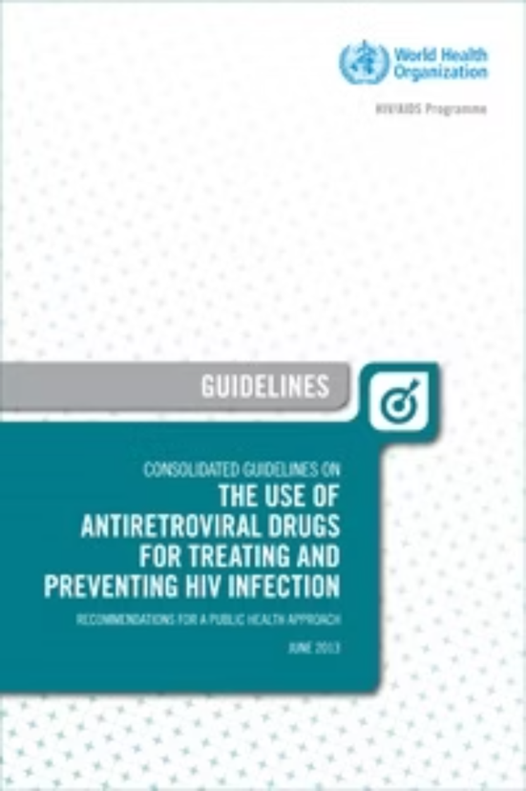
Strategic Directions: Revising Diagnostic Guidelines
Revisiting CD4 Testing
Enhancing Drug Resistance Testing
Current WHO guidelines (2021) recommend CD4 testing primarily at diagnosis or for suspected virologic failure, driven by historical cost. However, affordable point-of-care CD4 tests now make routine longitudinal monitoring feasible, especially in resource-limited settings. This is critical for timely care and improved outcomes for people living with HIV globally.
Current HIV drug resistance testing is limited to cases of confirmed treatment failure. However, the decreasing cost of genotypic resistance assays and rising treatment failures, even on dolutegravir regimens, warrant a re-evaluation of resistance testing strategies. Routine resistance testing at therapy initiation could ensure optimal regimen selection and prevent avoidable treatment failures, strengthening global HIV treatment programs.
In light of these developments, it is essential that WHO guidelines be updated to reflect the latest diagnostic advances and epidemiological trends.

Slide 16
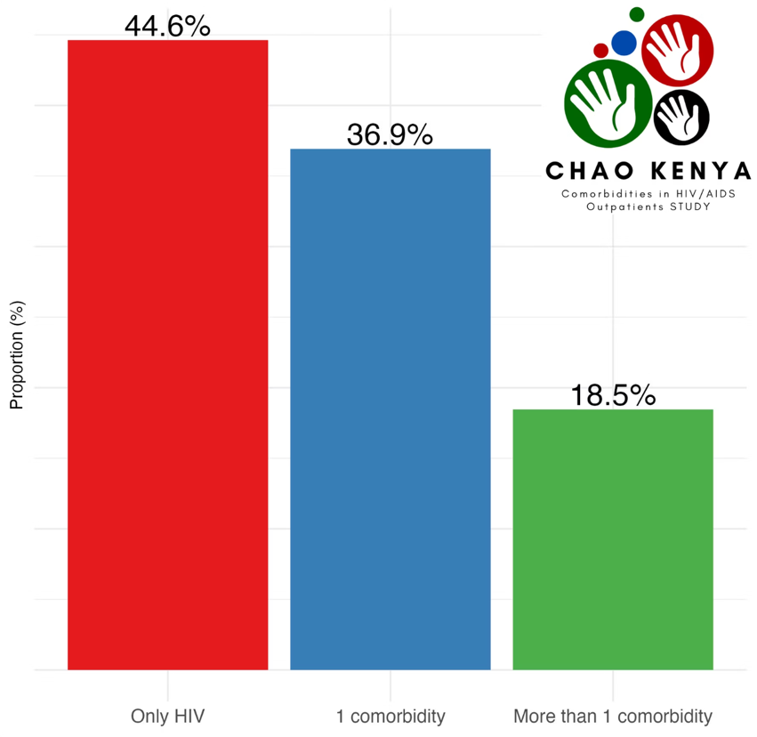
Co-Benefits of HIV/AIDS Investments
Approximately 40% of patients receiving HIV care present with at least one comorbidity
Rather than a zero-sum game, HIV investments demonstrate a multiplier effect across health systems:
Skills, infrastructure, and systems established for HIV care are adaptable to management of other chronic conditions
Community-based outreach models benefit multiple health programs
Laboratory networks and supply chains strengthen overall health infrastructure
Incorporating screening, diagnosis, and treatment of comorbidities into HIV programs generates substantial health benefits and potential cost savings.

Slide 17
Funding Trends and Future Concerns
In low-income countries such as Malawi or Mozambique, where HIV expenditures already exceed total public health spending, even minor funding reductions can precipitate service disruptions with cascading consequences.

Slide 18
The Path Forward: Ending AIDS by 2030
Sustained Financing
Ensure predictable and adequate funding to maintain continuity of care for millions, recognizing that HIV investments yield multiplier effects across health systems.
Quality Over Minimalism
Resist oversimplification of HIV services and maintain high standards for treatment and prevention, ensuring comprehensive care models that preserve quality, equity, and sustainability.
Integrated Approach
Strengthen integration of HIV services with tuberculosis and noncommunicable disease management for broader health system resilience.
Ethical Commitment
Uphold the moral dimension of the HIV response, born of solidarity and recognition of shared humanity, by ensuring no vulnerable populations are left behind.

Slide 19
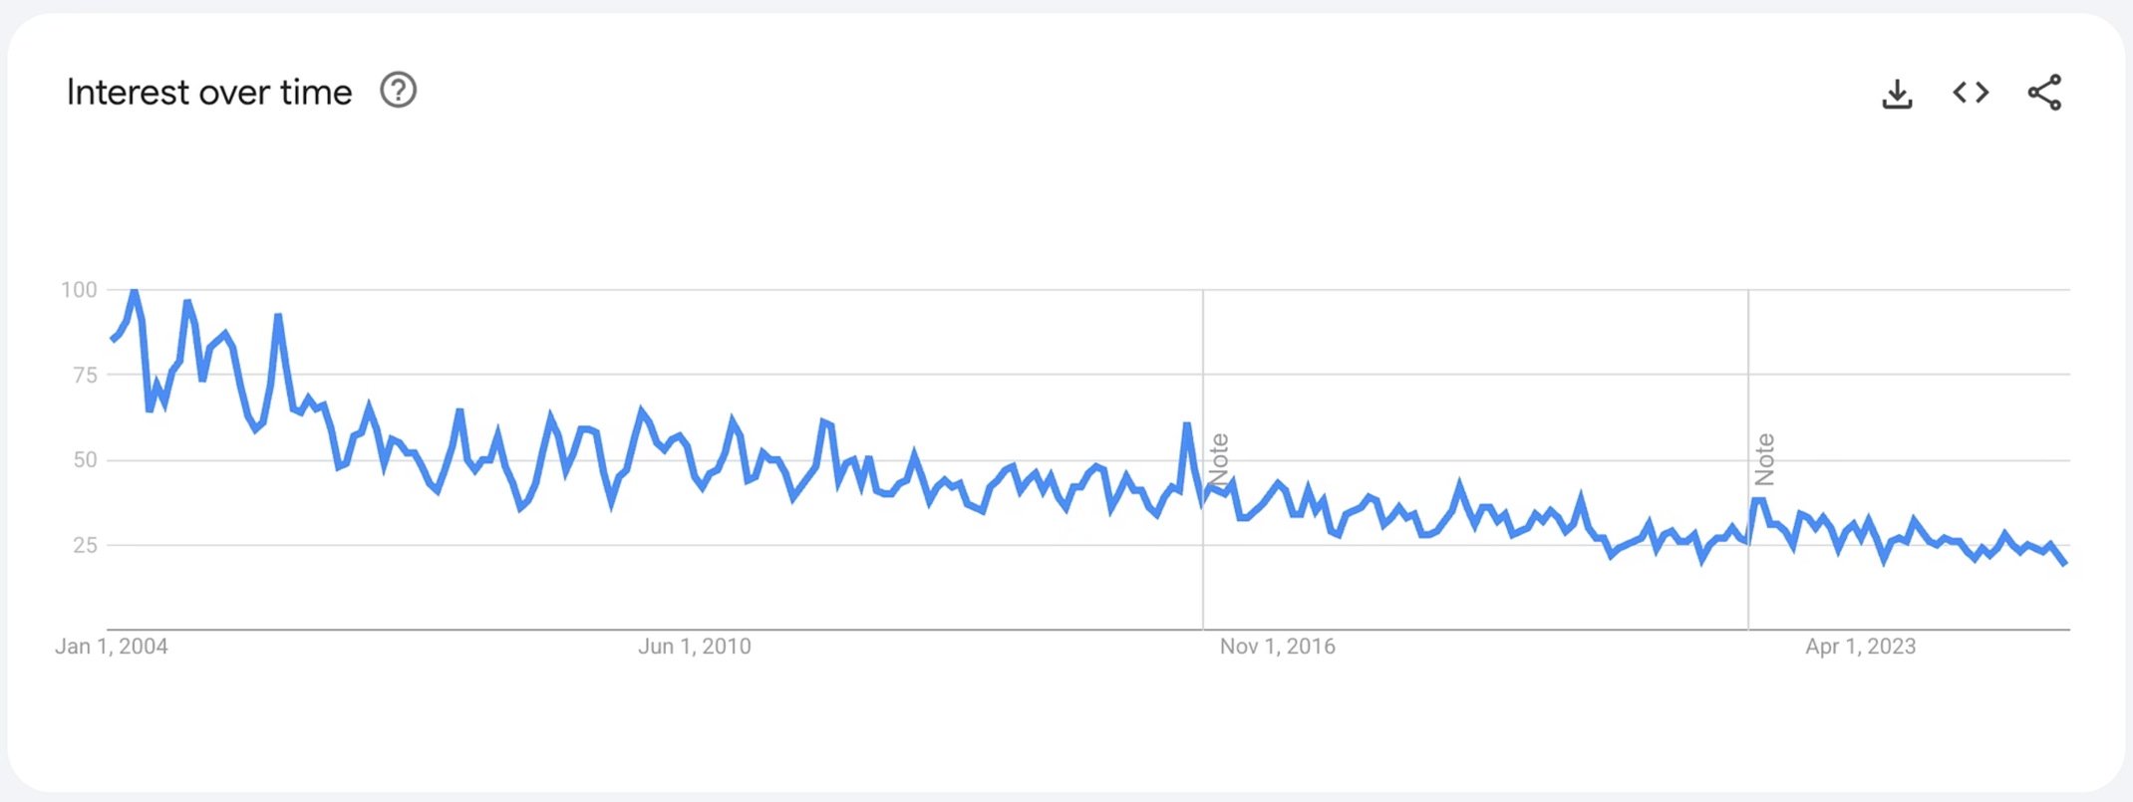
Stay Committed to HIV/AIDS
Google search trends for “HIV” and “AIDS” have declined steadily since 2004, reflecting reduced public interest. While imperfect, this indicator suggests waning visibility, which may contribute to policy complacency and donor fatigue. Sustained advocacy is essential to maintain momentum and funding amid competing global health priorities.

Slide 20
Thank you

